Slide 1
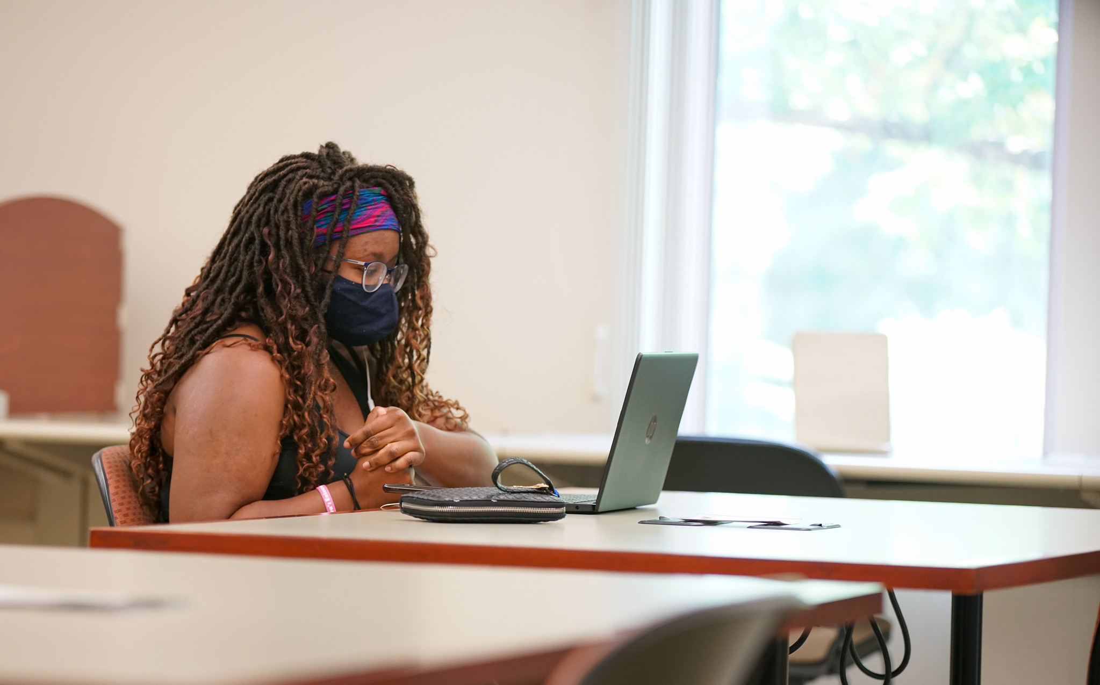
Built-in @ Booth
DEI as a Library Priority

Slide 2
REACT
What words come to mind when you hear “Library”?
Respond at PollEv.com/zacharynewel964
OR text ZACHARYNEWEL964 to 22333

Slide 3
Booth Library Strategic Plan Objective:
Build a culture that supports diversity and inclusion
Partner with stakeholder groups to promote diversity and inclusion in activities
Reflect diversity and inclusion in staffing
Promote diversity and inclusion in the Library and Information Studies career field
Emphasize intentionality
Collaborate with campus partners to support faculty, staff, and student retention for underrepresented members of our campus population
http://booth.eiu.edu/plan

Slide 4
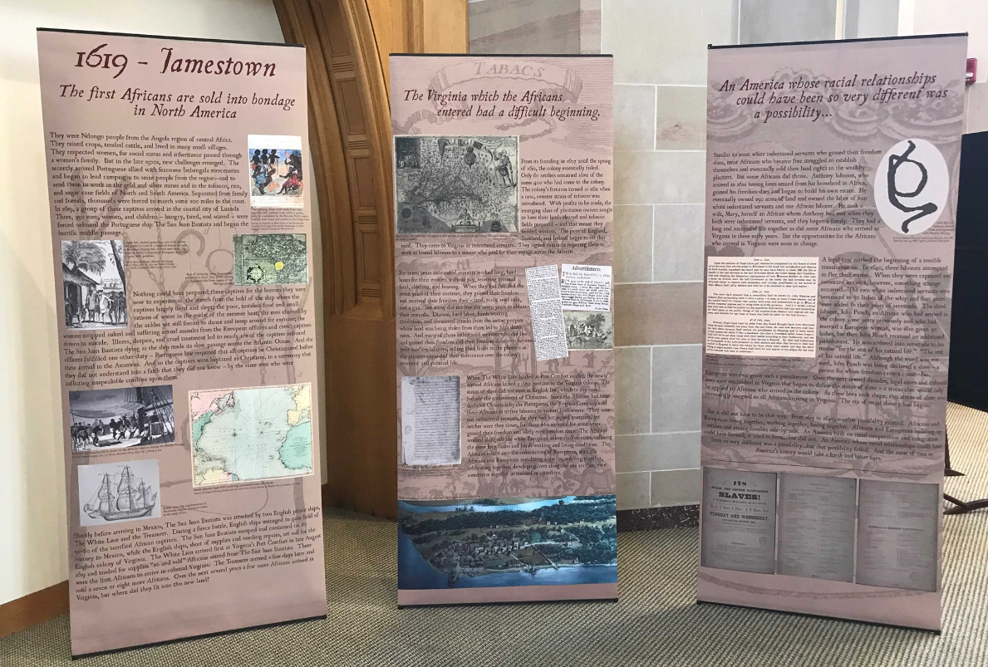
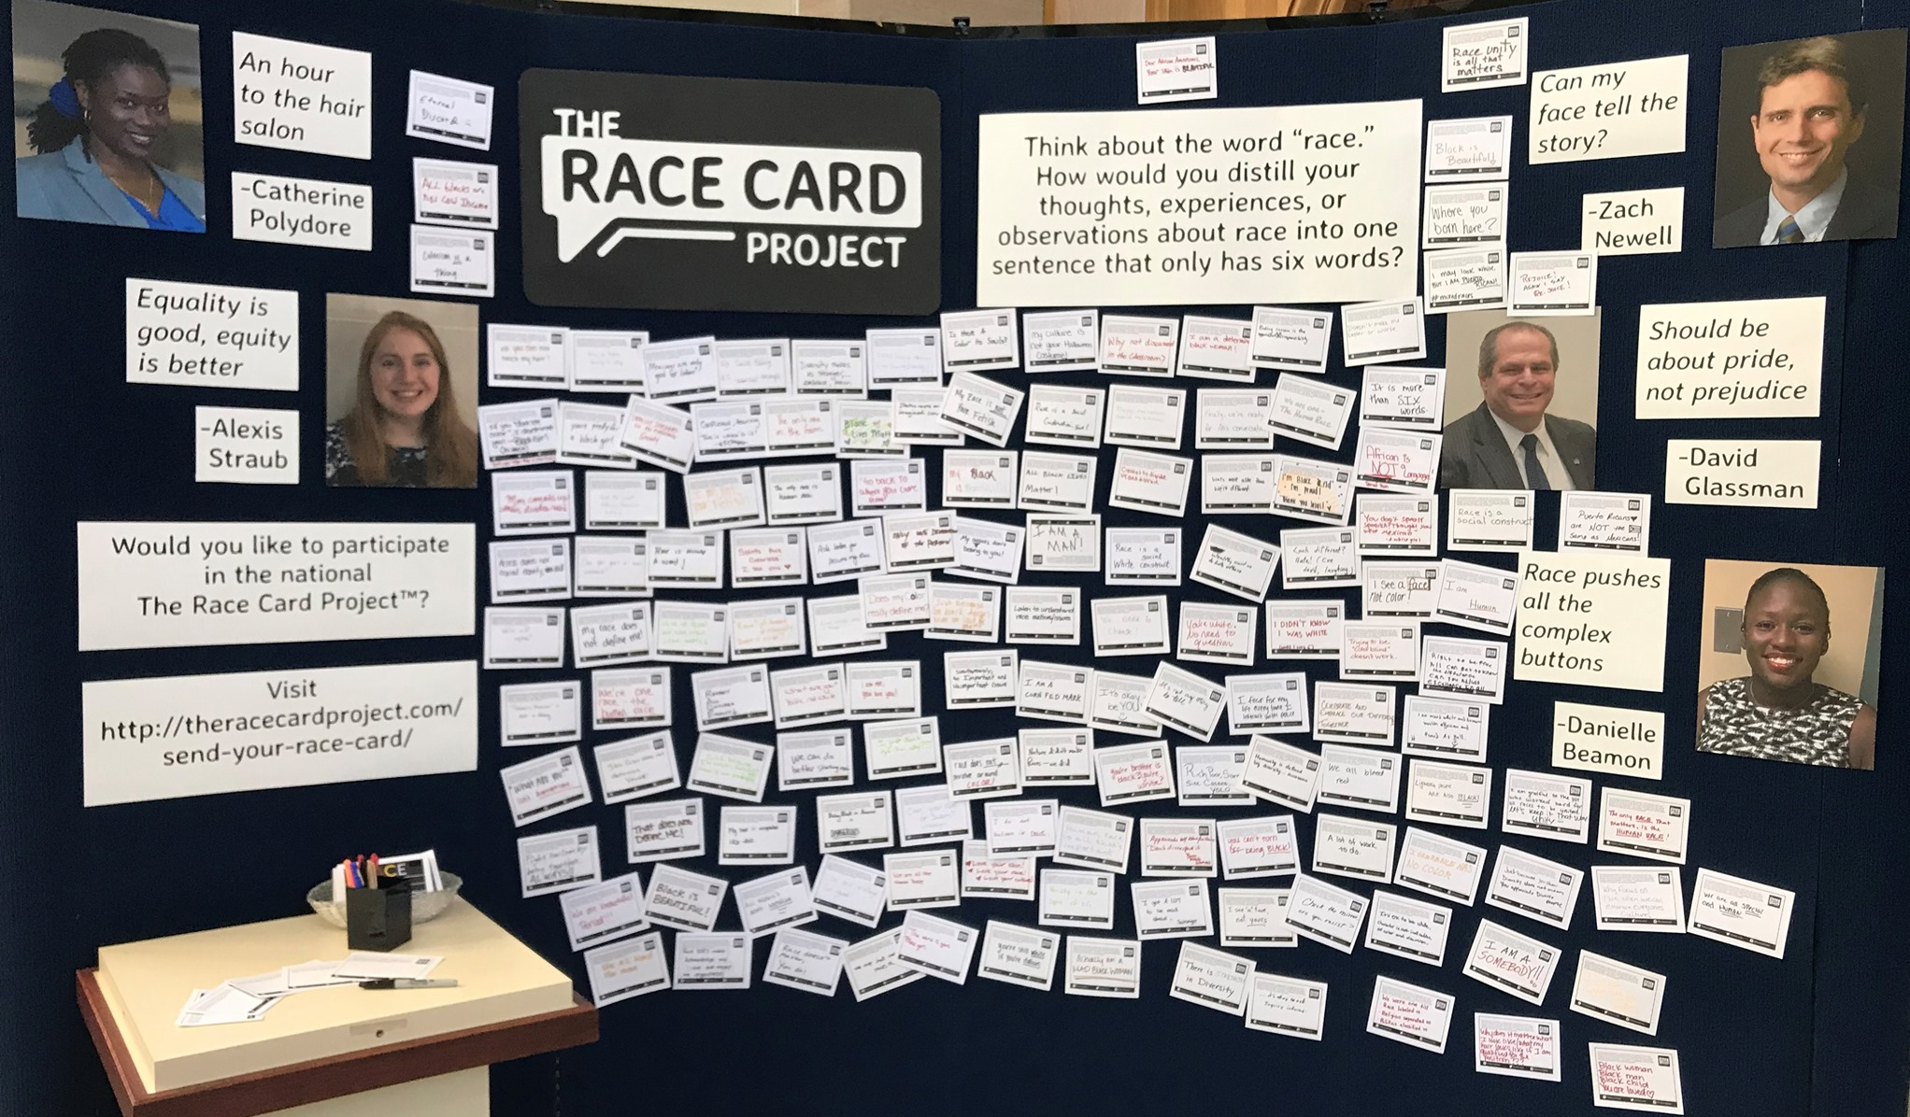
Emphasis/Exhibits & Programming

Slide 5
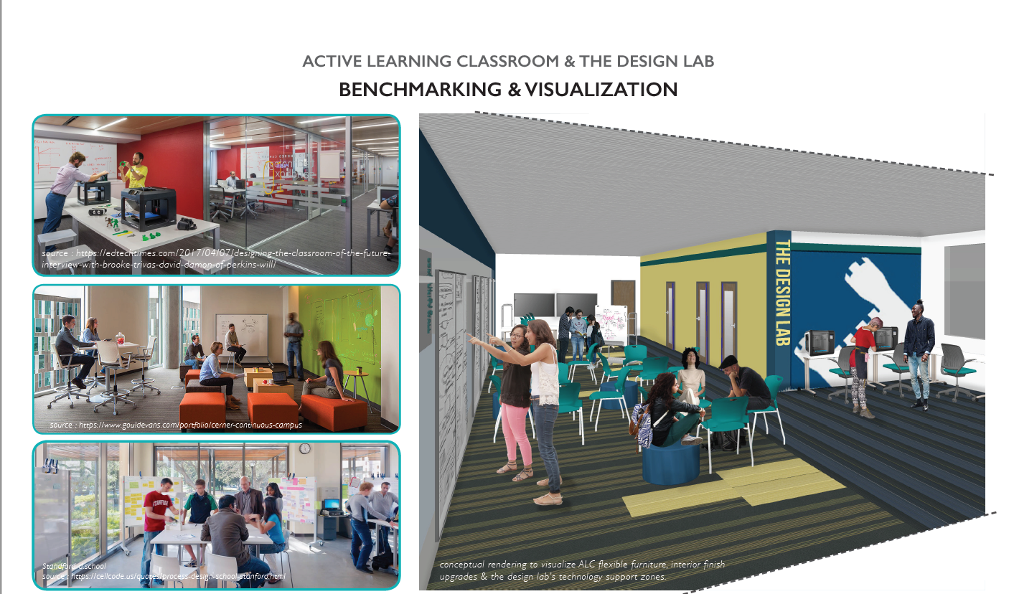
Emphasis/Spaces & Collections

Slide 6
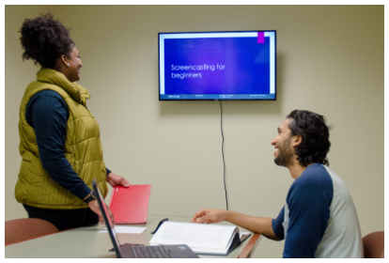
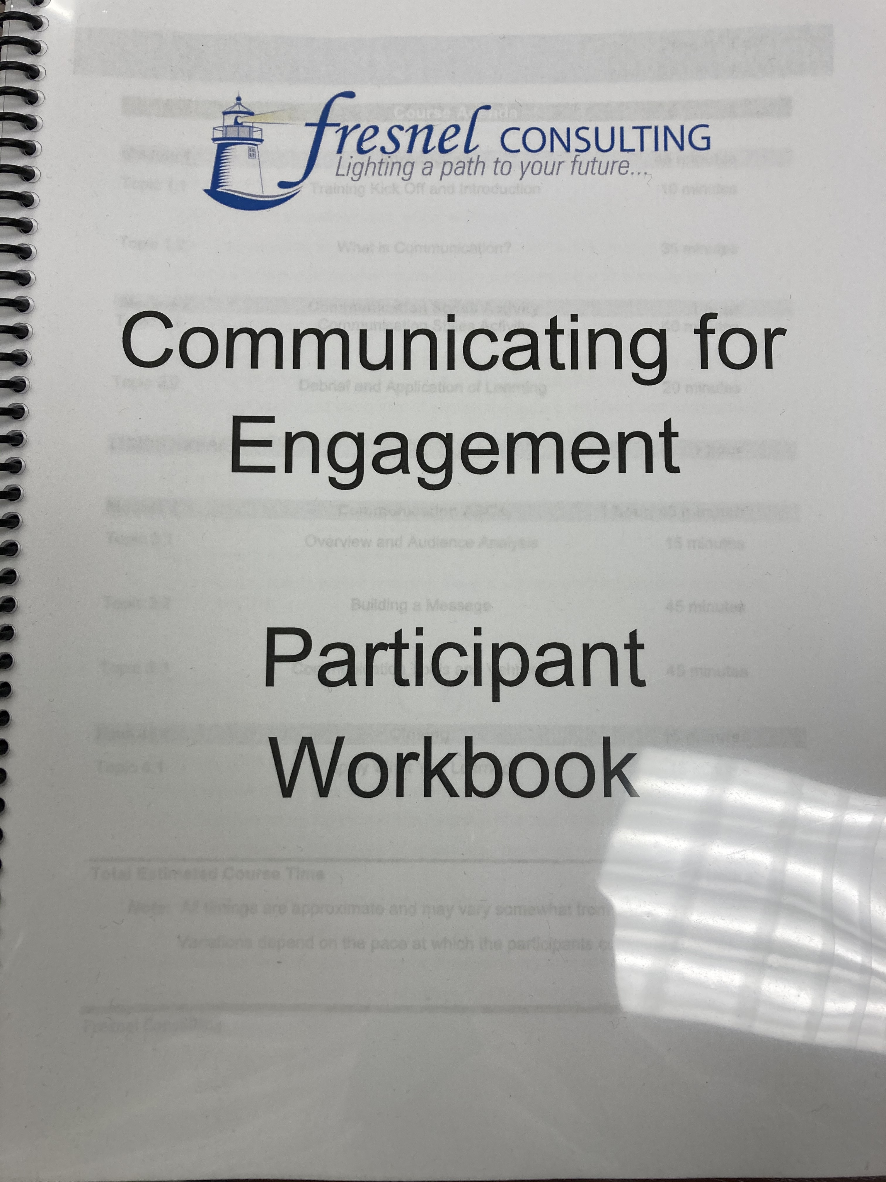
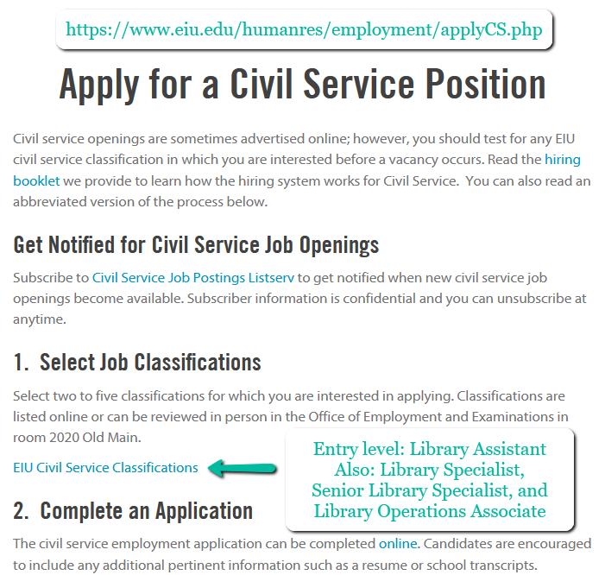
Emphasis/Personnel

Slide 7
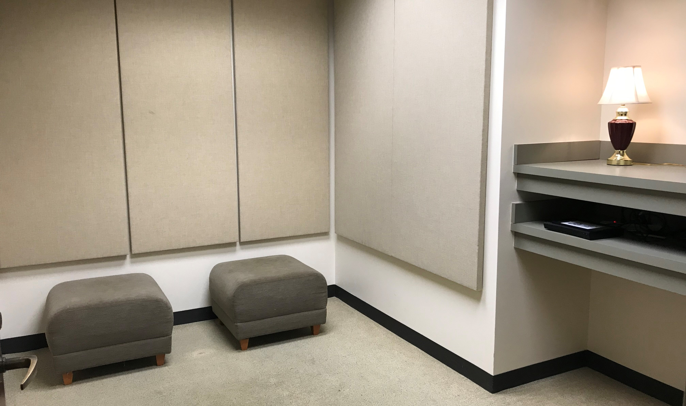
REFLECT
Breakout Rooms
Work on responses to questions -->>>>>>>>>
With whom can you (personally or as a department/organization) partner to enhance DEI initiatives?
What DEI initiatives are highest priority for your group?

Slide 8
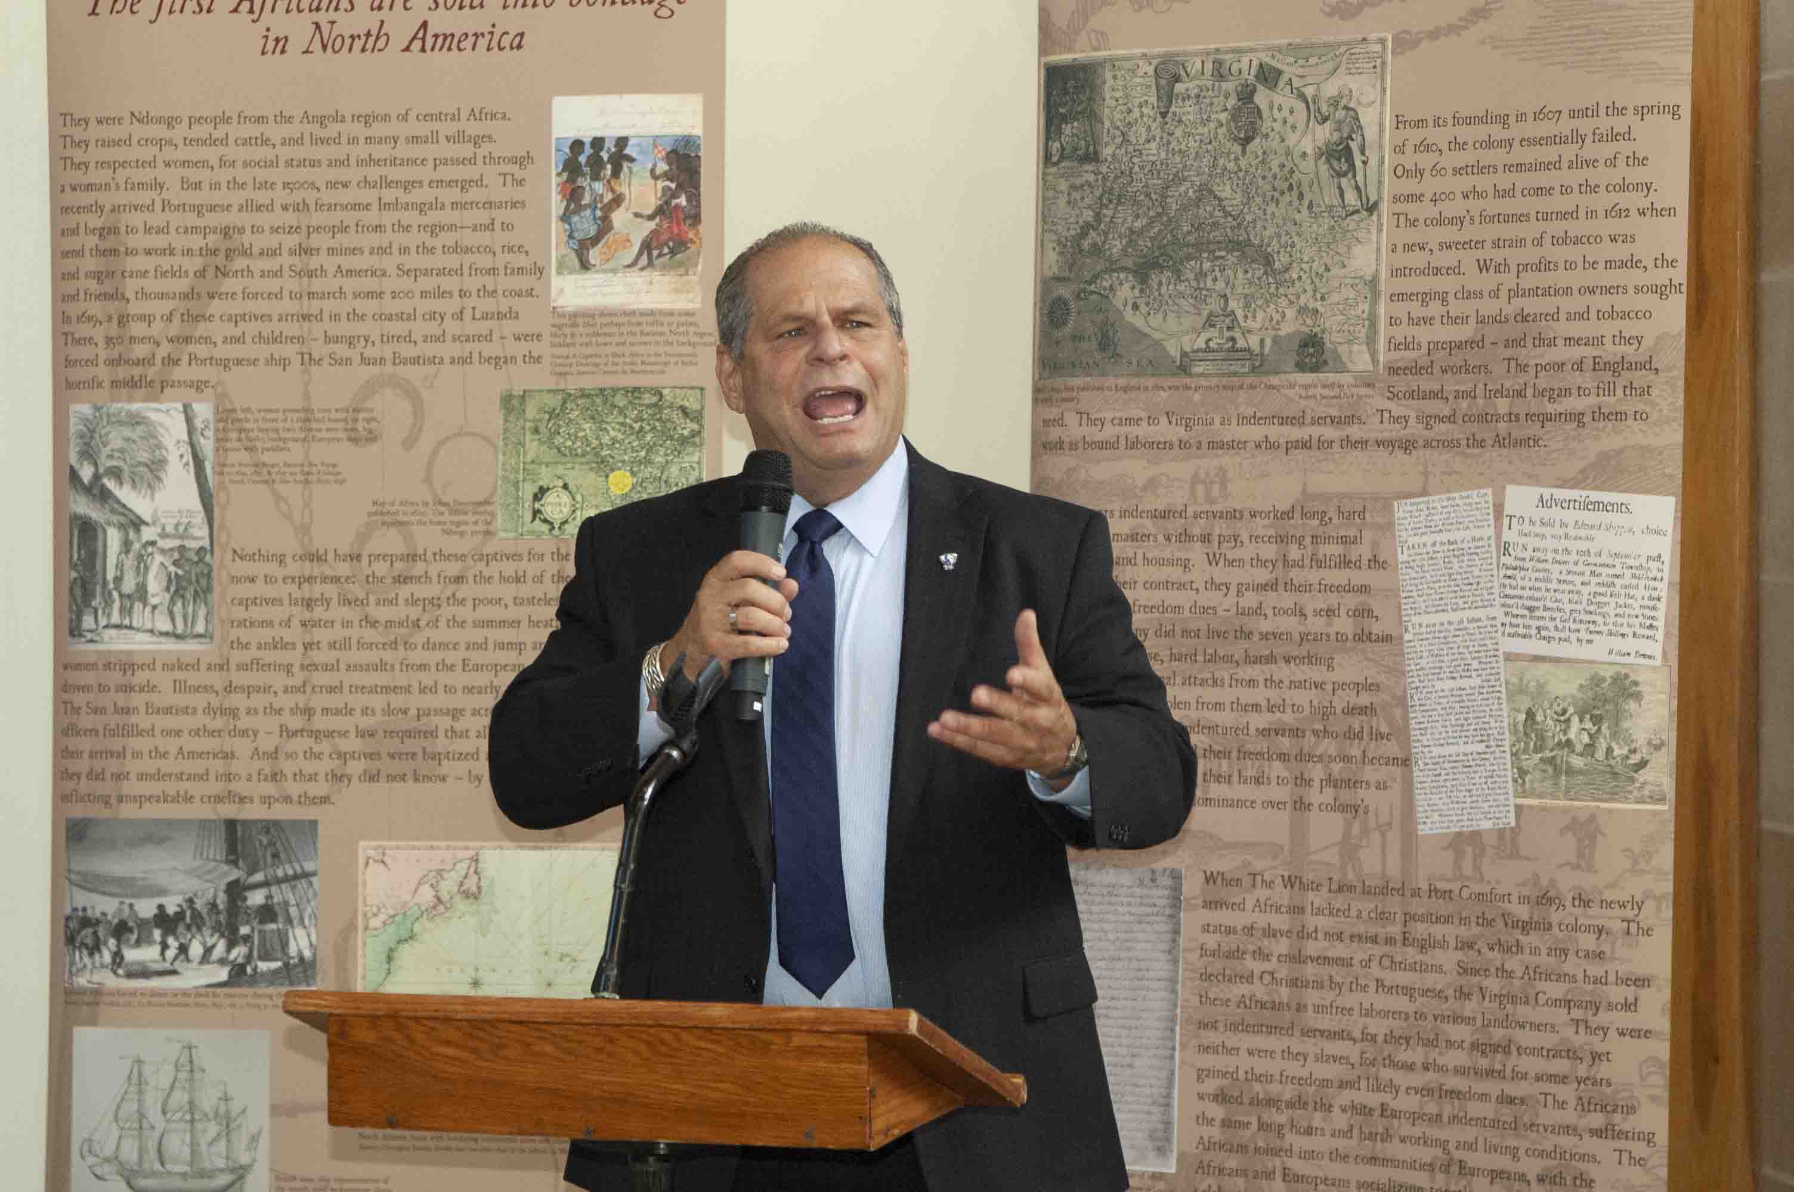
Next Steps
How do we continue to facilitate a conversation about diversity, equity and inclusion in the library?
How do we sustain partnerships?

Slide 9
WRITE
Jot down two action items that you’ll take away from this session.

Slide 10
Thank you!
Kirstin Duffin, Associate Professor, Research, Engagement & Scholarship Unit, kduffin@eiu.edu
Beth Heldebrandt, PR Director, Booth Library, emheldebrandt@eiu.edu
Stacey Knight-Davis, Professor and Head of Library Technology Services, Library Services, slknight@eiu.edu
Zach Newell, Dean of Library Services, znewell@eiu.edu

