Slide 1
Disrupting Norms to Increase Diversity of Teacher Candidates: Restraining Forces for Junior Faculty
Jennifer Buchter, Ph.D., MSW; Cori More, Ph.D., BCBA, Jennifer L. Stringfellow, Ph.D.
Department of Special Education
Eastern Illinois University

Slide 2
OUtcomes
Participants will identify how traditional practices act as barriers to diverse students
Participants will discuss how junior faculty can act as change agents within established systems.
Participants will examine their own goals and how they can work within university systems to support their work related to social justice.

Slide 3
Session Organizer
Review Diversity in Teacher Education
Apply Concepts to University Systems in Other Departments
Engage in Discussion re: Similarities and Differences
Arrive at Possible Next Steps

Slide 4
How We Arrived at this Moment
Teachers in the United States tend to be from a homogenous demographic group.
  The majority of teachers are White, middle class, and identify as female (Barajas, 2016;Constantine et al., 2008; Proctor & Truscott, 2012).
Faculty in institutions of higher education (IHE) mirror and maintain the lack of diversity of teachers in the American school system (Billingsley et al., 2019; Constatine et al., 2008; Grapin & Pereiras, 2019; Sutherland Harris, n.d.)
Increasing Diversity has been a goal for 60 years (Barajas, 2016; Widiputera, 2010)
This is NOTHING NEW

Slide 5
Previous Efforts to Address Issues
Recruitment efforts, Specialized Programs, Grow Your Own, etc. have led to no significant change since 2003(U.S. Department of Education, 2016)
The numbers of diverse teachers in our programs do not keep pace with the diverse demographics.
  Asian-American and Latinx suggesting may actually be decreasing despite efforts to increase teacher diversity (Berry et al., 2018; Billingsley et al., 2019; National Center for Educational Statistics, 2018)

Slide 6
Why Does it Matter
The need for an increasing diversity of teacher candidates to enter the teaching workforce is seen as critical in supporting an increasingly diverse student school population (Gist, 2017; National Center for Educational Statistics, 2018).
Diversifying the teaching workforce shows promise in reducing disparities in the following:
  suspension and expulsion rates
  educational outcomes
  retention
  graduation rates
  (Billingsley et al., 2019; Grissom et al., 2015; Peterson et al., 2016;Rocha & Hawes, 2009; van den Bergh et al., 2010)

Slide 7
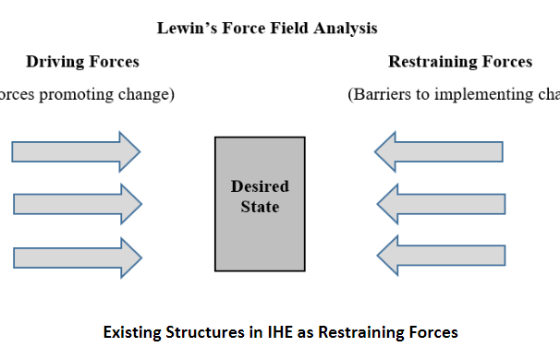
Theory of Change Lewin’s Force Field Analysis

Slide 8
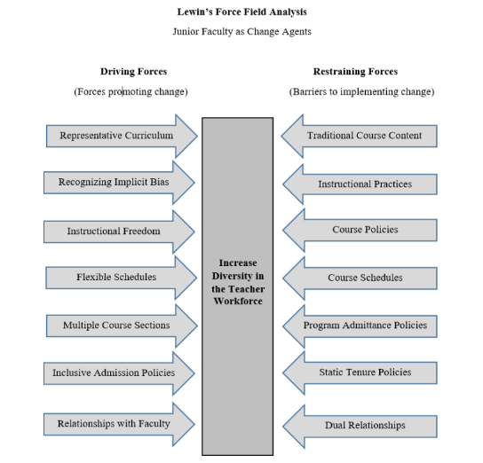
Theory of Change Lewin’s Force Field Analysis

Slide 9
Barriers
Traditional Curriculum
  Curriculum can lack representation of diverse people and experiences as well as the contributions of diverse leaders in the field (Hanesworth, et al., 2019).
  Educational systems can perpetuate whiteness as the standard or norm in which all others are measured (Ahmed, 2014; Gist, 2017; Haddix, 2016; Leonardo, 2009; Puwar, 2004; Rocha & Hawes, 2009; Souto-Manning & Emdin, 2018; Varghese, et al., 2019).
  The overall bias and default to whiteness has historically influenced what is important and valuable, therefore excluding other researchers and perspectives (Gist, 2017; Haddix, 2016; Leonardo, 2009; Souto-Manning & Emdin, 2018; Varghese, et al., 2019; Widiputera et al., 2017).
  Perception of right or the norm, thereby placing individuals who do things differently in a position of being inherently wrong, biased in whiteness, become ingrained as the standard of measurement (Gist, 2017; Haddix, 2016; Leonardo, 2009; Souto-Manning & Emdin, 2018; Varghese, et al., 2019).

Slide 10
Barriers
Instructional Practices
  In IHEs, professors often have instructional freedom to teach the content of the course in the way they deem best which is an important driver for change. While there are generally agreed upon course objectives that should stay the same no matter who teaches the course, the instructional practices used to address content varies from instructor to instructor.
  Inconsistencies related to rigor and grading can be a restraining force as perceived rigor can be a barrier (Chen, 2017; Lombardi et al., 2013).
  When instructional practices are geared towards increasing expectations for rigor without increasing support and/or when the rigor is not geared towards performance or skills teacher candidates need to be successful in the field, it creates a barrier that must be disrupted in order to attract needed populations of students

Slide 11
Barriers
Course Policies
  In 2017, 43% of full-time students were employed at least 20 hours a week (Chen, 2017; United States Department of Education, 2016).
    True for first generation college students, students from diverse backgrounds and life experiences, students as head of household, students who are parents, and students from lower socio-economic backgrounds (Chen, 2017; United States Department of Education, 2016).
  Specific policies
    related to attendance, when written rigidly, do not allow the unique needs for students to be met. A student who completes all assignments and exceeds expectations can be punished by a lack of attendance. When this occurs, attendance can become punitive rather than being geared towards increasing performance. While there should be an expectation that students attend classes, factors beyond students’ control (e.g., caregiver issues, illness, work rescheduling) can inhibit students, who may otherwise be successful teachers, from being successful in a teacher preparation program. Course policies such as the aforementioned become restraining forces for increasing diversity when students from diverse backgrounds are disproportionately impacted by course policies

Slide 12
Barriers
Course Schedules
  Course Times
  Static Courses
  Delay completion
  Additional course requirements (Fieldwork/practicums)
    Practicum hours and observation hours are beneficial for teacher candidates (Barahas, 2017) and most colleges and state licensure agencies have policies that prohibit students from being paid for their practicum work.
    While the purpose of these policies may be related to mentorship and liability, this commitment of unpaid time can be a restraining force for all students, but especially students from diverse backgrounds who are often disproportionately working to support themselves through college (Chen, 2017).

Slide 13
Barriers
Program Admittance Policies
Students are admitted and declare a major, but then must apply to be fully admitted/accepted into individual programs of their choice, such as teacher education.
Each program sets its own standards for admission, guided by accreditation standards and, if not periodically re-examined, act as a restraining force that results in maintaining the status quo.
Accreditation can encourage programs to strictly adhere to grade point average (GPA) standards, standardized test scores and other criteria.
  In addition to being biased, these standards, however, may not be the best indicators of effectiveness in teaching (Barajas, 2016; Berry et al., 2018; Billingsley, 2019; Gist, 2017; Grapin & Pereoras, 2019; Grissom et al., 2015; Leonardo, 2009).

Slide 14
Junior Faculty as Change Agents
Inherent risk in engaging in change activities
  no guarantee that a proposed change will lead to a desired outcome
  junior faculty are vulnerable.
    “we have to protect our junior faculty” (Baker et al., 2012; Boyd et al., 2010; Constantine et al., 2008; Gillespie et al., 2004).
  balancing choices within the framework of their career trajectory while working around said restraining forces.
  conform to the restraining forces instead of identifying and engaging in driving forces, there is a postponement of disruptive critical work.
  operate their change initiatives while working in conjunction with tenured faculty who, a) will vote on whether they achieve tenure and, b) have advantages within the Department/College in terms of power/ownership to limit impact or initiative of change.

Slide 15
Junior faculty as Change Agents
Tenure is important for the protection of science and creation of new knowledge within the academy
The process by which IHE grant tenure can impede the work of junior faculty who wish to address the restraining forces that inhibit the ability to diversify the teacher pipeline.
  Trajectory in teaching, research, and service and comes with strict guidelines and timelines.
    The promotion and tenure system is weighted more heavily to acknowledge permanent work products such as positive course evaluations from students and published research articles in peer reviewed journals vs. the process of promoting change and the failures that come with working towards change.
  Dual Relationship: tenured faculty member is both a colleague and evaluator of the junior faculty member.
    The ranks of assistant, associate, and full professor are provided as a framework for advancement but, in essence, establish a hierarchy..
    Further, if peers have a deeply held conviction that the traditional practices are rigorous and essential for teacher preparation, then the disruptive practices, such as flexible due dates or transformative content, may be interpreted as undoing the Department’s previously established work, or not preparing teachers for the “real world”.

Slide 16
Theory of Change Lewin’s Force Field Analysis

Slide 17

Discussion

Slide 18

Dr. Jennifer Buchter
Dr. Cori More
Dr. Jennifer Stringfellow
Department of Special Education
Eastern Illinois University

