Slide 1
Striking a Match to Institutional Bridges: Co-Conspiring to Overcome Barriers to DEI Work
Alex Berry
&
Clarice Thomas, Ph.D.
Notes:
Alex kick off

Slide 2
ABSTRACT
At the height of national civil unrest, demands for justice can be heard over the silence of institutional racism. Two student affairs professionals co-conspire to address the need for equity and inclusion work at their community college. Using their respective theoretical frameworks, the presenters discuss their efforts to change institutional requirements for diversity coursework and professional development for faculty and staff. The presentation will highlight the college context of resistance, and changes that have been implemented in the most recent academic year. This session has implications for administrators and faculty members and will offer suggestions for others to engage in collective and individual practices that center a more just and equitable campus environment for all students.
Notes:
Clarice

Slide 3
LEARNING OBJECTIVES
Understand the importance of an explicit stance on Diversity, Equity, and Inclusion (DEI) work in an institution
Examine how DEI work contributes to student success in the classroom and beyond
Identify ways to enact an anti-racist pedagogy
Identify barriers that may exist in your institution
Notes:
Alex

Slide 4
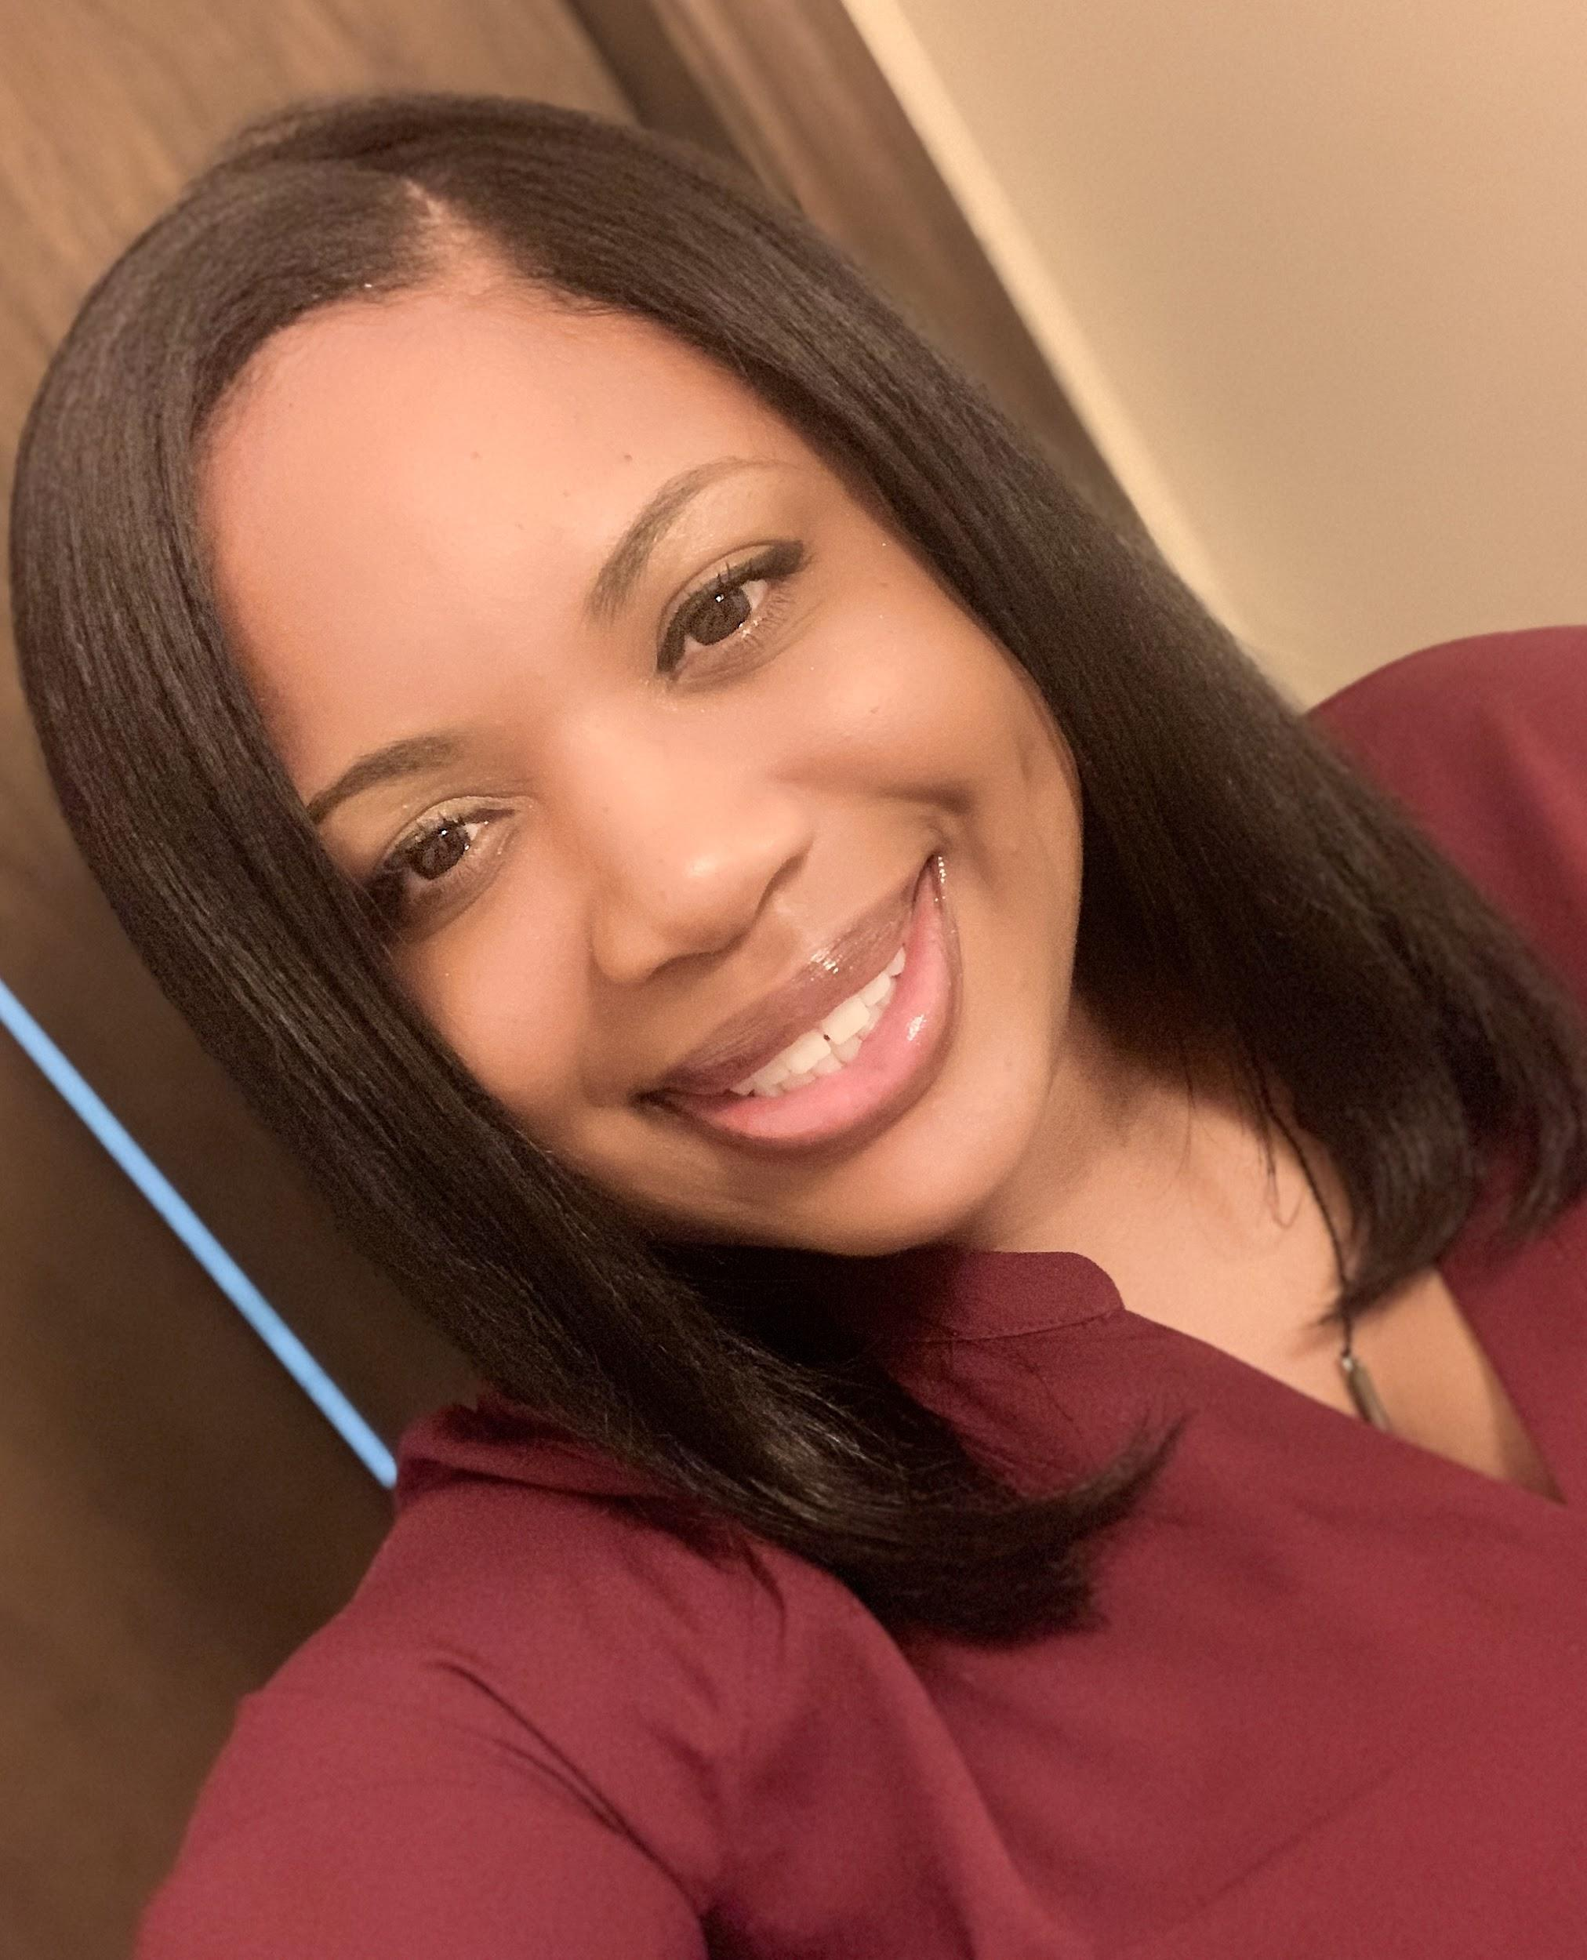
Who we are
Alex
Clarice
Notes:
is the Director of Student Development/Title IX Coordinator at Richland Community College. He is also a current Ph.D. student in the Educational Administration & Foundations department at Illinois State University. Alex’s areas of research interest include Critical Whiteness Studies, discourses of whiteness, and has taken a recent interest in critical communication pedagogy.
is a Student Success Coach at Richland Community College. She is a narrative inquirer with a research focus on teacher education, the school-to-prison nexus, and Black experiences in education.

Slide 5
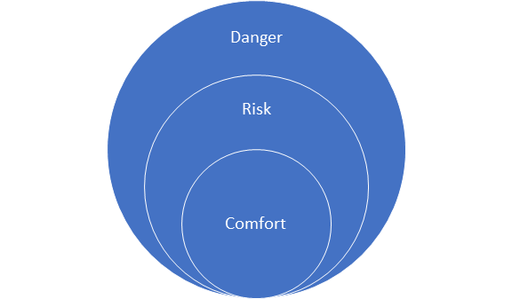
Zones of Comfort--Where are You?
Notes:
Clarice/Alex

Slide 6
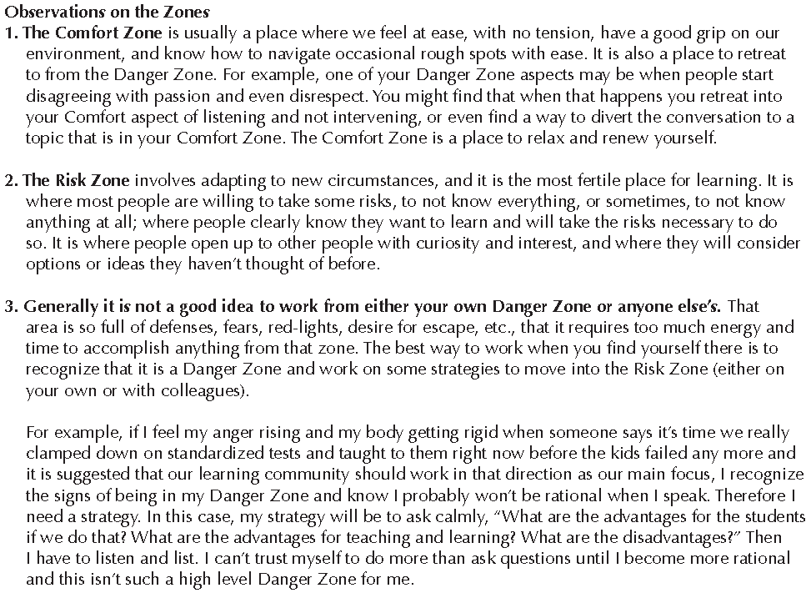
Notes:
Clarice

Slide 7
Anti-blackness
“There is no Black self that is not already suspect, that is not already targeted for death in the literal sense and in terms of ‘social death’” -Michael Dumas
Notes:
Clarice

Slide 8
Anti-blackness
Acknowledges:
There is trauma associated with being racialized Black and navigating an anti-black world.
There is a structural reality that ties Blackness to slavery.
Wilderson (2020) says, “One is born into social death as one is born into gender or a class; but it is also constructed by the violence and imagination of other sentient beings. Thus, like class and gender, which are also constructs; not divine designations, social death can be destroyed” (103).
Notes:
Clarice

Slide 9
Whiteness
White people’s customs, cultures, and beliefs serve as “normal.”
White feels normal and is viewed as normal
Whiteness saturates our society and higher education. (Who was higher education built for?)
“In this country, American means white. Everybody else has to hyphenate.” -Toni Morrison
Notes:
Alex

Slide 10
Critical Whiteness
Critical Whiteness Studies is defined as “a transdisciplinary field of inquiry that seeks to dismantle white supremacy by identifying whiteness as the source of the problem” (p. 105)
Core tenets:
CWS rejects the idea that people of color are the source of the problem
Moves away from viewing whiteness solely as a social construct with no true consequences
Matias & Rucker (2018)
Notes:
Alex

Slide 11
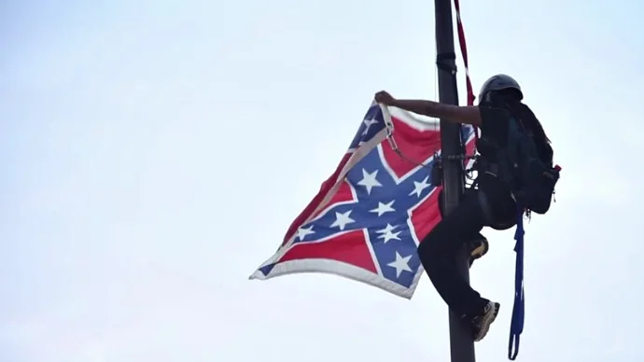
ALLY vs. CO-CONSPIRATOR
According to Bettina Love (2019), “allyship is working toward something that is mutually beneficial and supportive to all parties involved” (116).
Co-conspirators use their privilege and power to challenge anti-blackness.
Co-conspirators work towards social change while understanding their privilege, unlearning practices and habits that support systems of oppression, and develop authentic relationships.
Notes:
Clarice

Slide 12
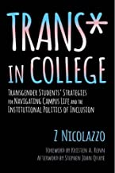
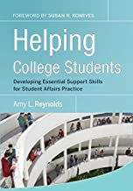
The Work: Advising to Coaching
Notes:
Alex

Slide 13
Non-Western
&
Diversity Requirement
All Associate in Arts & Associate in Science students must satisfy an IAI Non-Western or Diversity course from either the Social & Behavioral Sciences or the Humanities & Fine Arts groups.
What a process…
Nov. 2018 to Feb. 2020
Notes:
Alex

Slide 14
Antiracism
“The active process of identifying and eliminating racism by changing systems, organizational structures, policies and practices and attitudes, so that power is redistributed and shared equitably.” -National Action Committee on Status of Women International Perspectives
Making the move from not racist to antiracist
Notes:
Clarice

Slide 15
Intersection of Antiracism & Teaching
How to be an Antiracist Educator (Simmons, 2019)
Engage in vigilant self-awareness
Acknowledge racism and the ideology of white supremacy
Study and teach representative history
Talk about race with students
When you see racism, do something
Empower and Power
Antiracism & Allyship in the Classroom
Notes:
Clarice & Alex

Slide 16
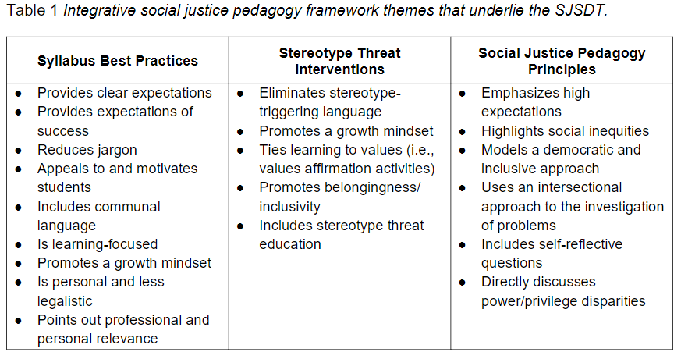
From Taylor et al., 2019
The Social Justice Syllabus Design Tool: A First Step in Doing Social Justice Pedagogy
Notes:
Alex

Slide 17
“All Your Skinfolk--Ain’t Your Kinfolk”
“Educators have to be cautious they are not using respectability politics to socialize students into a structure of White dominance.”
-Dr. S. F. Welch
Notes:
Clarice

Slide 18
Aligning Values & Actions
Notes:
Clarice - sensationalism--business as usual
Diversity Core Value- changing
DEI Committee

Slide 19
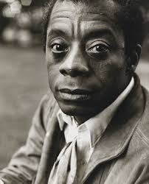
“Not everything that is faced can be changed, but nothing can be changed until it is faced.” -James Baldwin

Slide 20
Don’t speak for; rather, speak with or in support of (Alcoff, 1991)

Slide 21
Your turn
Take a few minutes to think of some barriers at your own institution. What can be done to overcome those barriers? Who can be a co-conspirator?

Slide 22
What questions do you have?
Thank you!
Connect with us!
Alex: aberry@richland.edu | Clarice: cthomas@richland.edu

Slide 23
Resources
Love, B. (2019). We want to do more than survive: Abolitionist teaching and the pursuit of educational freedom. Boston: Beacon Press.
Matias, C. E., & Rucker, J. (2018). When whiteness creeps back in: An analytic look at whiteness in urban education school reform. Whiteness and Education,3(2), 103-121. doi:10.1080/23793406.2018.1528476
ross, k.h. (2021). On Black education: Anti-blackness, refusal, and resistance. In Grant et. al. The future is Black. Pp. 7-15. New York: Taylor & Francis.
Style. E. (1996) Curriculum as window and mirror. Social Science Record. First published in Listening for All Voices, Oak Knoll School monograph, Summit, NJ, 1988.
Taylor, S., Veri, M., Eliason, M., Hermoso, J., Bolter, N., Van Olphen, J. (2019). The social justice syllabus design tool: A first step in doing social justice pedagogy. The Journal of the National Conference on Race and Ethnicity in American Higher Education.
Wilderson, F. (2020). Afropessimism. New York: Liveright Publishing.

