Slide 1
Intersectionality as a Framework to Develop Best Practices to Improve Access to Higher Education for Marginalized Groups
Danielle Bank Disability Support Services Coordinator, Dominican University
Manmohan Kaur Professor (Mathematics), Department of Mathematics, Benedictine University
Pat Somers Assistant Professor (Clinical Psychology), Director of Intercultural Education, Department of Psychology, Benedictine University

Slide 2
Combahee River Collective
“Intersectionality is important because it is the core root of why the Collective was fighting for their rights due to multiple kinds of oppression. It was clear that women of color experienced sexism, sexual oppression and racism all at the same time.”

Slide 3
What is intersectionality?
The ways in which social identities (race, ethnicity, religious affiliation, ability status, gender, sexual orientation, socioeconomic status, age, citizenship/immigration status, etc.) uniquely interact, overlap, amplify, and converge in the experiences of individuals and groups and result in their marginalization and discrimination.

Slide 4
Intersectionality
Intersectionality is an approach that simultaneously analyzes the effects of multiple categories of social group membership. (Cole, 2008)

Slide 5
Intersecting Points of Oppression
Multiple marginalized identities do not simply sum the total degree of oppression, but rather multiply it.

Slide 6
Overlapping and Intersecting Identities
Sexual Orientation
Ability Status
Gender
Ethnicity
Religion
Class
Citizenship Status
Race

Slide 7
Why is intersectionality important?
It provides a framework for the analysis of systemic, structural, political, and economic oppression.
Unless solutions to injustice, inequality, and inequity consider the implications of intersectionality the solutions will be ineffective – and they will suffer from ‘intersectional blindness.’

Slide 8
Intersectional Struggles
“There were those of us who by virtue of our experience. . . recognized that we had to figure out a way to bring these issues [race, gender, sexuality, imperialism, class, etc.] together. They weren’t separate in our bodies, but also they are not separate in terms of struggles.” – Angela Davis (Freedom is a Constant Struggle, 2015)

Slide 9
Intersecting Commonalities
Understanding the points of common oppression shared by different marginalized groups can also result in collaboration and coalition-building.

Slide 10
Network of Mutuality
100 years later…
Dr. Martin Luther King Jr.’s April 16, 1963 Letter from the Birmingham Jail, addressed to his fellow clergymen, claimed that:
“Injustice anywhere is a threat to justice everywhere. We are caught in an inescapable network of mutuality, tied in a single garment of destiny. Whatever affects one directly, affects all indirectly.”

Slide 11
Best Practices
Cultivate intersectional awareness in our students -- each with their unique socially constructed set of identities.
Foster in our students the ability to simultaneously affirm and value their own racial, ethnic, religious, etc. lived experiences while also building coalitions with others, who differ from them in various ways, but who share points of intersecting struggle.
Help our students recognize that we are united in a “single garment of destiny” each contributing to a common tapestry and to the common good.
Institutional climate change through training faculty, staff, and administration in anti-bias and anti-racism practice.

Slide 12
Best Practices in STEM: An Intersectional Approach to Support Marginalized Groups

Slide 13
Role of Mathematics in STEM Retention
Mathematical preparation predicts success in STEM (TAL, Seymour et. al., 1997)
Calculus I has a profound contribution to the rates of freshmen switching out of STEM majors (Survey by Mathematical Association of America, David Bressoud, 2015)
SAT math score predicts switching, SAT verbal/reading does not.
More than expected students switch out of Mathematics/CS (TALR, Elaine Seymour et. al. 2020)
Notes:
Disclaimer: I am not a social scientist

Slide 14
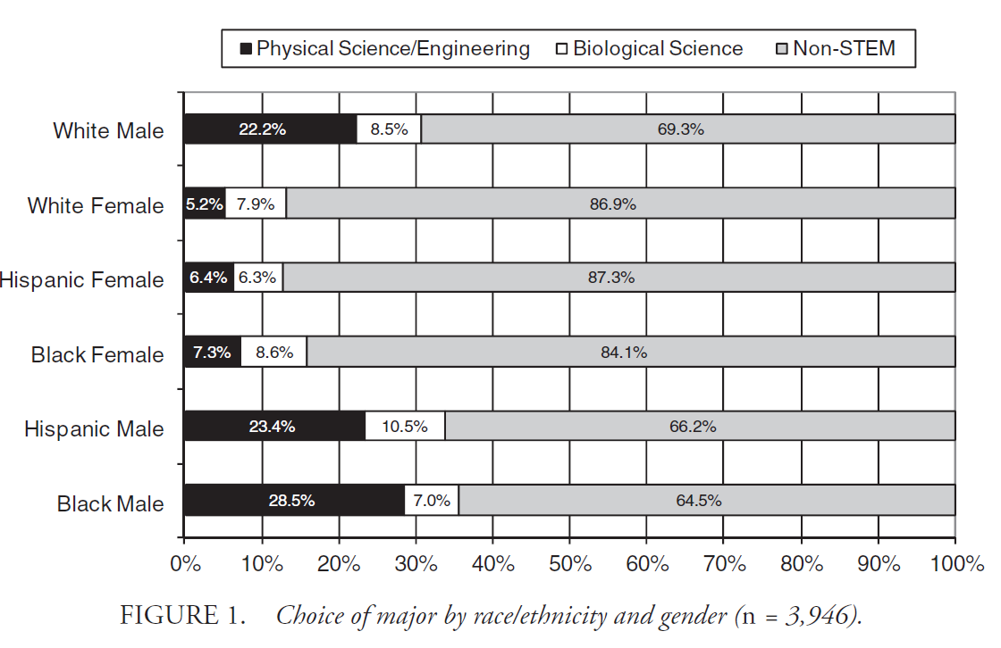
Major by Race/Ethnicity and Gender
Riegle-Crumb & King 2010
Edu. Res.
Notes:
Riegle-Crumb & King 2010
This is an older but comprehensive figure

Slide 15
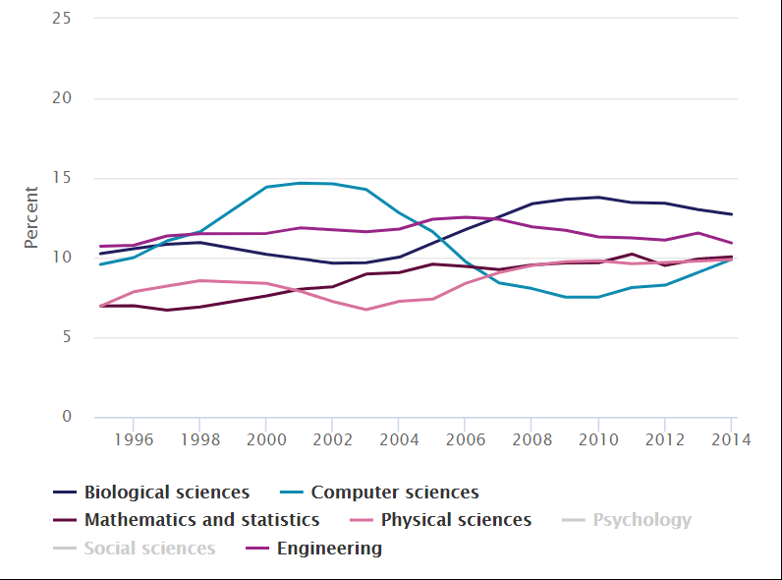
Science & Engineering Bachelor’s Degrees Earned by Field: 1995–2014
Females
Hispanics
African Americans
Notes:
Riegle-Crumb & King 2010

Slide 16
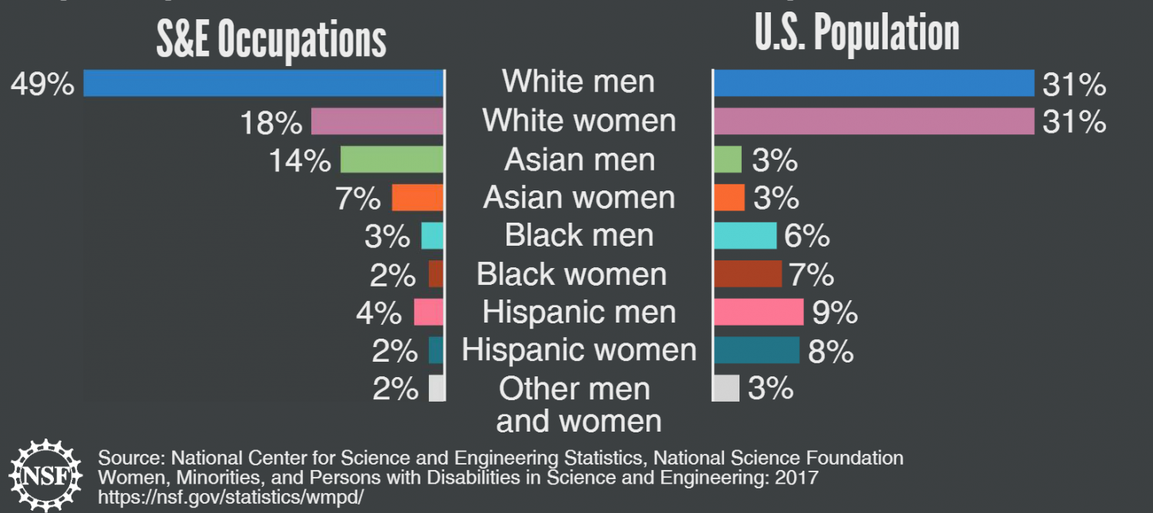
Workers in Science & Engineering Occupations
In 2015, women and some minority groups were represented less in science & engineering (S&E) occupations than they were in the U.S. general population.
Notes:
Riegle-Crumb & King 2010

Slide 17
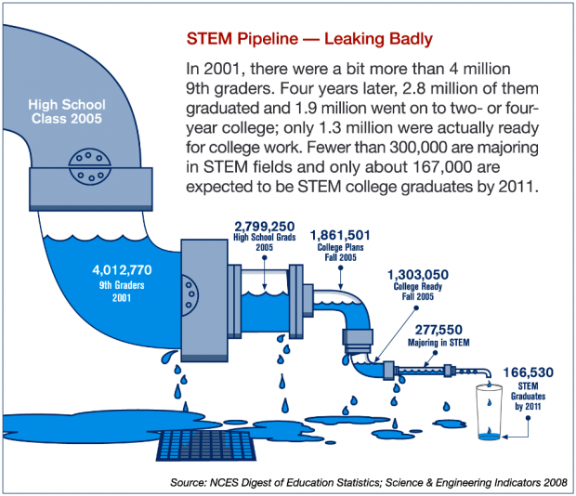
STEM Pipeline: Leaky
Leaks worse for women and minorities
Notes:
Some evidence: leaks earlier for minorities, later for women.
Our responsibility – in red.
Really: Out students are responsible for the rest …
… so we’re responsible for all of it.

Slide 18
Why do students leave STEM?
TAL (1997)
TALR (2020)
Three main factors for switching:
Push Factors
Pull Factors
Pragmatic
Major factor: Learning experiences, and NOT student’s intellectual or personal inadequacies
Factors are compounded with intersectionality
Notes:
Talking about Leaving: Why Undergraduates Leave the Sciences (Elaine Seymour & Nancy M. Hewitt, Westview Press, 1997)
Talking about Leaving Revisited : Persistence, Relocation, and Loss in Undergraduate STEM Education
Elaine Seymour, Anne-Barrie Hunter, Heather Thiry, Timothy J. Weston, Raquel P. Harper, Dana G. Holland, Andrew K. Koch, and Brent M. Drake (Springer, 2020)
The study restricted to high scoring students * selected students who did not lack the requisite ability to complete STEM majors (who entered college with math score of more than 650 SAT or 28 ACT, so had demonstrated math ability).
Large N, Well distributed sample
Three main factors for switching:
Push Factors: poor teaching, overwhelm created by heavy pace/load, rigid curriculum structure of STEM majors, misalignment of course elements
Pull Factors: non-STEM offered more interest and better education
Pragmatic: made original choice less promising or feasible (profit to grief ratio, financial rewards – return on investment
Learning Experiences: course design, teaching quality, classroom culture, securing help with academic difficulties

Slide 19
Unchanged from 1997 to 2020
Factors contributing to switching out of STEM are the same
Student experiences have converged over time – regardless of gender and race/ethnicity
Findings did not differ significantly by the type of institution
Persisters and switchers are not different types of students
STEM learning experiences play a major role
 | Switchers | Persisters
STEM Instructor Pedagogy | 96% | 72%
STEM Curricular Design | 85% | 56%
Under-preparation | 64% | 34%
Conceptual Difficulties | 80% | 42%
Difficulty Gaining Timely Help | 80% | 31%
Lost Interest | 60% | 61%

Slide 20
Gender Differences: 1997 to 2020
Women tend to blame themselves, their loss of confidence, not being able to deal with the competitive climate in STEM.
 | 1997 |  | 2020 |  | Switchers |  | Persisters
 | Men | Women | Men | Women | Men | Women | Men | Women
Loss of Interest | 44% | 43% | 54% | 66%
Poor Teaching | 39% | 33% | 46% | 49% | 96% | 97% | 71% | 72%
Loss of Confidence | 27% | 20% | 51% | 67% | 71% | 84% | 37% | 89%
The competitive Climate in STEM | 26% | 4% | 46% | 56% | 74% | 85% | 30% | 52%
Problems of STEM Curricular Design | 42% | 29% | 34% | 30% | 95% | 82% | 55% | 59%

Slide 21
Race/Ethnicity Differences: 1997 to 2020
Overall difficulties of persistence for students of color not significantly different from 20 years ago. (TALR, 2020) More than other factors, students of color blame themselves or their high school preparation for their struggle in STEM courses.
 | Students of Color | White | Switchers SoC | Switchers White | Persisters SoC | Persisters White
Under-preparation | 35% | 13% | 73% | 60% | 41% | 31%
Difficult Transition to College | 73% | 31% | 96% | 86% | 78% | 45%
The Competitive Ethos of STEM | 62% | 49% | 88% | 79% | 60% | 32%
Loss of Confidence | 69% | 59% | 92% | 74% | 59% | 35%

Slide 22
Marked Change from 1997 to 2020
Discovering an aptitude for a non-STEM field (from 10% to 76% in switching decisions)
Loss of confidence (from 23% to 61% in switching decisions) High among all switchers 79%, persisters 44%
Competitive class climate (from 14% to 52% in switching decisions)
81% of all switchers and 42% of persisters
Effects greatest among women of all races/ethnicities, and men of color
Problems in financing college (from 30% to 70% for switchers and from 23% to 48% of persisters)
Career related concerns
Notes:
Career related concerns: * Choosing STEM majors for reasons that prove inappropriate (from 14% to 48% in switching decisions) Created problems for 68% of all switchers and 22% of persisters.
Rejection of STEM careers and lifestyles (from 29% in TAL to 58% in TALR) Switch to non-STEM field offers more appealing career opportunities (from 27% in TAL to 54% in TALR)
System-playing moves to achieve career goals and/or graduate with higher, more competitive GPA (from 7% in TAL to 26% in TALR)

Slide 23
Given the same GPA, women leave STEM more
Women left STEM with grades higher than the average grades both of men who left and those who remained. (McLelland 1993)
“Senior women testified that developing an independent sense of their own ability and progress had been vital to their survival.”
“Women felt that they could win male acceptance, in academic terms, by losing it in personal terms.” (TALR,2020)
No gender difference in math ability: Women outperformed men in a study of Calculus I Students. (Lindberg et al. 2010) Women fail to progress from Calc I to Calc II at the rate of 1.5 times greater than men.
More than other factors, students of color blame themselves or their high school preparation for their struggle in STEM courses.
Notes:
Look at page 25

Slide 24
An uneven playing field
Consequences for college transition and survival in early stages of STEM majors that arise from disadvantages of social class, race, ethnicity and gender, including:
Under-preparation in the K-12 system
Problems arising from choice of majors or career pathways
Poverty, lack of financial support, need to work while in college
Gender and minority stereotyping: implicit and explicit biases
Prevailing gender roles: “raising a family” societal constructs

Slide 25
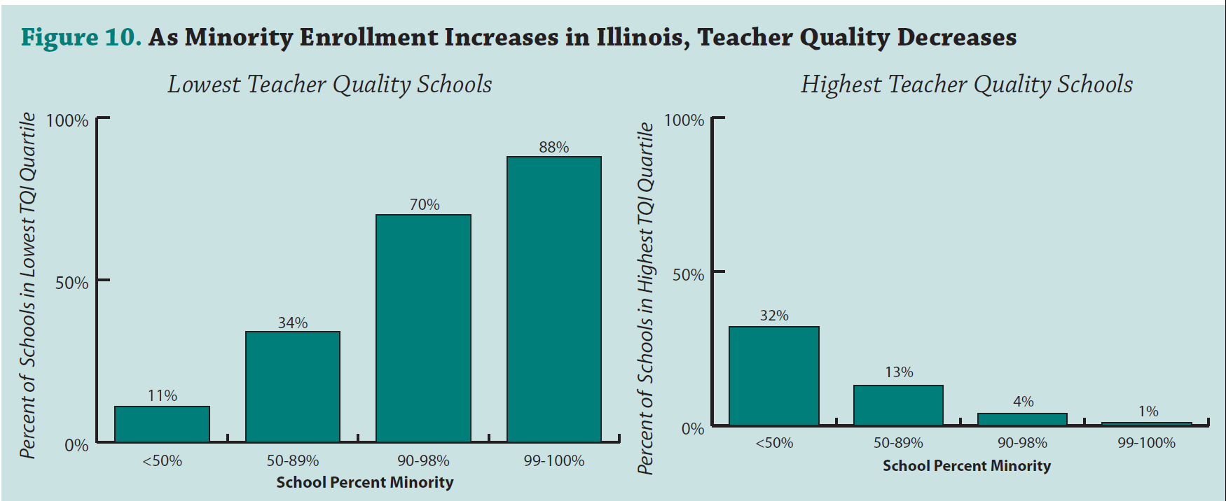
Teaching Inequality at Underrepresented Racial Minority (URM) Schools
Notes:
The Illinois Education Research Council linked multiple measures of teacher quality into an overall “index,” called the Teacher Quality Index (TQI),
Teaching Inequality: How Poor and Minority Students Are Shortchanged on Teacher Quality A Report and Recommendations by The Education Trust 2006 By Heather G. Peske and Kati Haycock

Slide 26
Teaching Inequality at High Poverty Schools
Notes:
The Illinois Education Research Council linked multiple measures of teacher quality into an overall “index,” called the Teacher Quality Index (TQI),
Teaching Inequality: How Poor and Minority Students Are Shortchanged on Teacher Quality A Report and Recommendations by The Education Trust 2006 By Heather G. Peske and Kati Haycock

Slide 27
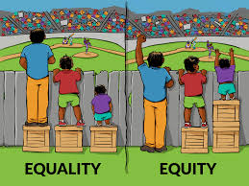
So what can we do?

Slide 28
Best Practices: Instructor Pedagogy
Curriculum (Structural Design)
Coherence
Material distributed
Different parts of the course (labs/class)
What is taught vs. what is assessed
Curved Grading
Dichotomies:
STEM | Non-STEM
Coldness | Warmth
Elitism | Democracy
Aloofness | Openness
Rejection | Support

Slide 29
Best Practices: Awareness & Timely Support
Awareness of Inequities
Teacher cares for student learning
Connection between the student and the teacher
Share research related to inequities with students
Timely help during first two years of college
Academic help
Advising help
Intervene to support student persistence during introductory courses (also known as weed out courses)

Slide 30
Best Practices: What can students do?
Explore your resources! Get informed about the issues and join the conversation!
Join or create a student club and have your voices heard on campus – ask for more support and/or change!
Find role models that inspire you and reach out!
Apply for yearly need-based and academic scholarships!
National STEM Summer Research Programs: http://pathwaystoscience.org
Resources for women:
https://500womenscientists.org/
Request a Woman Scientist platform: https://500womenscientists.org/request-a-scientist/
Connect our multidisciplinary network of women in science with people who need a scientist for a news story, a keynote speaker, a panelist, a collaborator, or a subject matter expert
Expanding Your Horizons is a national organization that hosts one day conferences to encourage girls to pursue STEM careers
Notes:
Fempower
500 women scientists

Slide 31
Action Items for Faculty
Education is an organic process, as opposed to linear
Education feeds the spirit
Fast food model of teaching
Get more informed about the issues
Join the conversation
Inspire others; Be a mentor!
Notes:
Get more informed about the issues
Join the conversation; help change the narrative in the classroom!
https://www.theopennotebook.com/2016/08/23/including-diverse-voices-in-science-stories/
Inspire others; BE a mentor!
https://www.skypeascientist.com/
Support students inside and outside the classroom
Include a Diversity and Inclusion Statement in your syllabus (see handout);
weave attention to diversity and inclusion throughout contours of class
Foster a GROWTH mindset model of student learning instead of FIXED model
Foster performance-approach goals (“how to best succeed”) and discourage performance avoidance goals (“how NOT to fail”)

Slide 32
Best Practices in Disability Services: An Intersectional Approach to Support Marginalized Groups

Slide 33
By the Numbers
“Data from the National Center for Education Statistics indicate that higher education enrollment rates of students with disabilities climbed from 10.9% of all students in 2007–2008 to 19.5% in 2015–2016 (National Center for Education Statistics, 2019; Snyder, de Brey, & Dillow, 2016).”
10.9%
19.5%
2015-2016
2007-2008

Slide 34
Transition Factors
Self-Advocacy
Disability Support Models
Disclosure
Institutional Structures Impacting Degree Completion
Access to Disability services

Slide 35
Best Practices
Establish cross-institutional partnerships developing a pipeline for students with disabilities with desired academic profiles
Create bridge programming that provides students with the opportunity to:
Understand the accommodations process at the university level
Practice engaging in self-advocacy
Develop a network of on-campus supports within and outside of Disability Support Services
Provide pre-enrollment course options for credit to allow for credit buffering and timely degree completion

Slide 36
References
Cole, E. R. (2008). Coalitions as a model for intersectionality: From practice to theory. Sex Roles: A Journal of Research, 59(5–6), 443–453.
Collins, P.H. (2019). Intersectionality as critical social theory. Durham: Duke University Press. https://www.dukeupress.edu/Assets/PubMaterials/978-1-4780-0646-6_601.pdf
Collins, P.H. & Bilge, S. (2016). Intersectionality. Polity Press.
Combahee River Collective https://combaheerivercollective.weebly.com/
Cooper, A. J. (2017). A voice from the South: By a Black woman of the South. University of North Carolina at Chapel Hill Library.
Crenshaw, K. (2005). Mapping the margins: Intersectionality, identity politics, and violence against women of color. In R.K. Bergen, J. L. Edleson, C. M. Renzetti (Eds.), Violence against women: Classic papers. (pp. 282–313). Pearson Education.
Davis, A. (2016). Freedom is a constant struggle: Ferguson, Palestine, and the foundations of a movement. Haymarket Books.
Heumann, J. E. (2020). Being Heumann: An unrepentant memoir of a disability rights activist. Beacon Press.
Hooks, b. (1994). Teaching to transgress: Education as the practice of freedom. Routledge.
National Center for Special Education Research: Institute of Education Sciences (2011). The post-high school outcomes of young adults with disabilities up to 8 years after high school: A report from the National Longitudinal Transition Study-2 (NLTS2).
Newman, L.A., Madus, J.W., Lalor, A.R., Javitz, H.S. (2020, February 3). Effect of accessing supports on higher education persistence of students with disabilities. Journal of Diversity in Higher Education. Advance online publication. . http://dx.doi.org/10.1037/dhe0000170
Seymour, E. & Hewitt, N. (1997). Talking about Leaving: Why Undergraduates Leave the Sciences. Westview Press.
Seymour, E., et. Al. (2020). Talking about Leaving Revisited: Persistence, Relocation, and Loss in Undergraduate STEM Education. Springer.

Slide 37
Scenarios
You ask the students in your Physics I class to pair up. You see that the only two black students in the class are in opposite corners. You watch as people mull about - everyone else pairs up and the two of them eventually find each other.
What could you have done to lessen (rather than highlight) the marginalization of the two students?
Calculus students in your class are asked to work in groups of 3.
Tori is an outgoing – and very good – student, but one day she finds herself in a group with two guys. You notice that she is not participating as usual. When asked after class, she tells you that the boys kept interrupting her & ignoring her ideas – so she decided to just work by herself.
What do you do?
01
02
Notes:
1: Fair ≠ Equal
2: from Physics Ed. research. Their solution: no groups of 2 men and 1 woman. Really 2 problems: Her opportunities, their sexist actions.

Slide 38
Scenarios
Mary is a 22-year-old undergraduate student studying Biology. In order to graduate, she needs to complete a capstone project with a male professor in her department. Her project is close to completion, but it ultimately needs his approval. Mary feels uncomfortable working with this professor, because he makes inappropriate comments and gestures towards women in general. He asks her to meet with him off- campus to have coffee and talk about her project. What should Mary do in this situation?
You are working with another student on a presentation for your math class. You are anticipating some disagreement and potential difficulty communicating because your partner is American and you are Chinese. Because of this social distinction, you find yourself focusing on other differences such as culture, upbringing, and experiences. You will likely work harder to explain and defend your ideas, even foregoing them for your partner’s ideas. How could you develop a fruitful and equal partnership despite these potential language, social, and cultural barriers?
03
04
Notes:
4: https://www.scientificamerican.com/article/how-diversity-makes-us-smarter/

