Slide 1
Level up on Diversity, Inclusion, and Equity
~Jack Blahnik
Notes:
Good Morning everyone. My name is Jack Blahnik and I currently serve as the esports graduate assistant for campus recreation at Illinois State University. I’m excited to share some insights from my work and reading I’ve done the past 6 months as it pertains to equity in virtual environments. As a student, I appreciate all the work you all have done in these challenging times to help meet the needs of our students while transitioning your courses from face to face to online. I hope that some of the strategies shared today you find helpful as we look to what we can change now and into the future. Regardless of what happens in the spring, it’s integral we are employing Equity-Minded and Culturally- Affirming teaching practices in all teaching environments. Thank you to Eastern Illinois and the RISE Committee for this opportunity. Thank you to Illinois State University's Campus Recreation, David Kirk and Dawn Pote. Without them, I wouldn't be doing what I'm doing now. And lastly thank you to my mom. Whom without her unconditional love and support, I don't know where I would be. You challenge me to be the best version of myself every single day.
-Please note that this session is being recorded and a full session of this will be available online within 48 hours.

Slide 2
Objectives
Discuss the ways in which our students, and particularly those that are apart of marginalized communities are disproportionally impacted in virtual environments
Propose strategies to infuse diversity, inclusion, and equity into your teaching and engagement in online settings
Examine Esports through an equity-minded lens
Notes:
The objectives for this session are as follows: read slides
It is my hope that we do not lose the momentum so many of us built up in an effort to be more equitable going into the spring, but rather to re-engergize those of you that are engaging in this work already. To those of you listening that have not yet started or don’t know how, then you will walk away from this talk with actionable items you can implement TODAY.

Slide 3
Considerations
This session focuses on online and virtual engagements in a collegiate setting.
This session prioritizes strategies and practices in esports.
As many of you know, this work requires intentional, relentless practice and engagement in the literature surrounding diversity, inclusion, and equity. It is encouraged to continue pursuing, learning, and self-discovery even after this session.
Notes:
These strategies can be translated to all of your online interactions with students.

Slide 4
Understanding Equity
Equity – Fairness Access to the same opportunities
Basic Needs Insecurities
Notes:
When thinking about Equity, it’s crucial we think frame Equity through an access lens. It’s also important to make a clear distinction between Equity and Equality. Equality refers to sameness, where as Equity can be thought of as “fairness”. This is especially important in virtual settings as not everyone may have access to the same equipment. They can also be battling basic needs insecurities such as food, housing, disabilities, etc.

Slide 5
Practicing equity Mindedness
According to Bensimon (2007) Equity Mindedness involves:
Recognizing the ways in which system inequities disadvantage minoritized people in a range of social institutions or contexts (education, employment, healthcare, the criminal justice system, etc.)
(re)framing outcome disparities as an indication of institutional underperformance rather than students’ underperformance;
Not attributing outcome disparities exclusively to students or perceived deficits in students’ identities, life circumstances, or capabilities;
Critically reflecting upon one’s role and responsibilities (as a faculty member, student affairs staff, administrator, counselor, institutional researchers, etc).
~Taken From Dr. Luke Wood and Dr. Frank Harris
Notes:
This information was taken from a webinar hosted by CORA learning and facilitated by Dr. Wood and Dr. Harris. I felt it perfectly encapsulated Equity mindedness. A common theme throughout this session will be that of choice. Living in this world of COVID-19 we have been challenged in ways we never thought possible and will certainly be written into the history books (or at least the ones that tell the full story). Now more than ever it’s imperative that we meet student’s where they are at. This notion shouldn’t stop when COVID-19 ends. I argue that our education system could use some reimaging. It’s not about whether or not the students are putting in effort, it’s not about whether they care. It’s our responsibility as those who interact with students to create a sense of belonging and community among our students. Specifically in higher ed, often times students are dealing with a lot of new things. A job, first time away from home, new classes and new experiences. So the question is not why are my student’s not trying, but what can I do to better serve my students? The power in in choice and perspective. We can choose to continue to blame students for failures, or we can accept responsibility by playing in integral part in their development as young professionals, and as people.

Slide 6
Three Major Challenges
Invisibility
Accessibility
External Pressures
Notes:
When it comes to online teaching, Dr. Wood and Dr. Harris identify 3 challenges to consider when engaging in virtual environments. We see this manifest itself into all areas of online learning, including esports.

Slide 7
Invisibility
“What I say does not matter”
Notes:
Particularly for people of color, a feeling of invisibility or worthlessness is often felt while taking classes. We see this feeling manifest itself even more while engaging in virtual spaces due to the lack of physicality. What I say does not matter. For people of color who are surrounded in predominantly white classes, this feeling is often supported and perpetuated by implicit bias, microaggressions, or even targeted assault. Now consider an online context. We don’t have the luxury of using non-verbals to help understand our environment and conversations. We may rely on text communication only, we tone can not often be expressed. For our students of color, they are now even more invisible. So what does that mean for us? We have to work even harder. We’ll go through some strategies on this later on.

Slide 8
Accessibility
“I don’t have a webcam”
Notes:
No doubt a phrase or notion that many of us are familiar with at this point. When you are able to get students attention in a virtual setting, often times we request or even require students to use a webcam. This can even be a requirement and something they get points that feed towards their final grade. How are we creating content that is accessible using multiple modalities, such as mobile phone?

Slide 9
External Pressure
“I have a lot going on”

Slide 10
Deficit Perspective
“Reject the deficit perspective"
Notes:
The onus is not on our students, but on us as influences and educators our young people's lives. The "blame must turn away from our student and particularly student of color, but to ourselves". Ask not what our student's should be doing, but what can we do for our students". We must be intentional about how we are supporting the lives young people. When determining what success looks like, we must take some institutional responsibility. Is this a reflection on me? This introspective is not meant to cast blame on ourselves, but do open us to the possibility that we can be doing more. Hopefully you are working in high education because you want to. I'm sad to say that some people are teaching even if they don't like teaching. Most of us set out to influence the lives of young people in a positive way. COVID-19 has forced us to adapt and stay fluid. Don't settle on the excuse of, it's just the effects of the pandemic. That's statement, that excuse, shouldn't work anymore. It can't work anymore. Our students need our support. How do our course designs perpetuate structural inequities? As Dr. Wood says "without a lens of equity, you have a lens of oppression".

Slide 11
Strategies for online engagements
Be Intrusive
Be Relational
Notes:
Here are a couple of strategies that I wanted to highlight and talk a bit more about. Being intrusive and being relational. While these are not the only stragtiegies for engaging students in an online enviornement, these are two important pieces of that story.

Slide 12
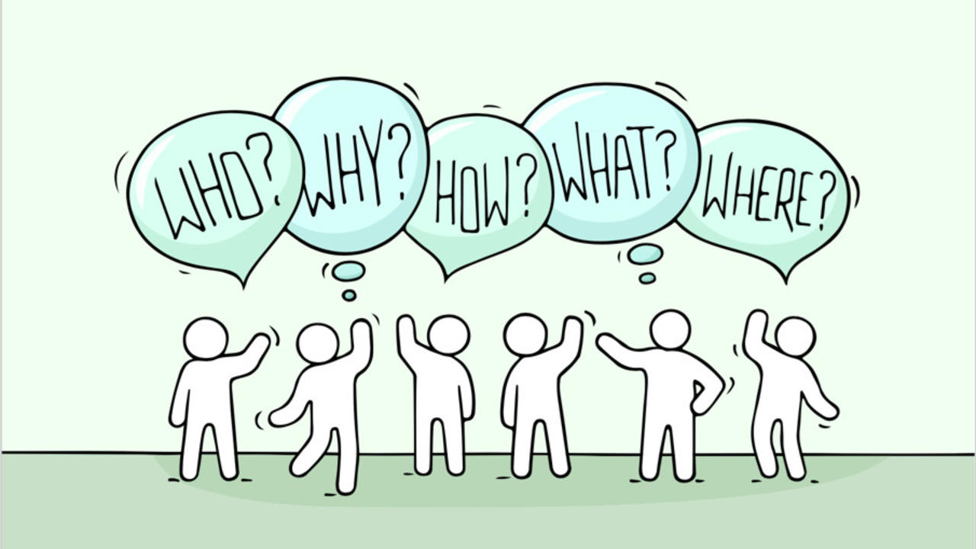
Intrusive
Notes:
Being intrusvie means we are being intentional about intervening in our students lives in a postive way. We have to be proactive in our approach. So what does this look like? We must not wait for students to reach out to us, but rather we should be reaching out to students. A one time reachout is not enough however. We must continue to touchbase with them throughout the semester, and possibly even beyond. This will help to ensure that no one is following through the cracks, that no one is left being unserved. One way to do this would be to conduct an informal assessment of students experiences in online learning. Ask the questions like, is this your first time taking an online course? How are you access the course (private computer, public computer, tablet, mobile phone)?, what concerns do you have about taking this course? How can I best faciliate your learning in this course? Any other concerns or information you would like to share?
Prepare and email to students a brief orientaiton video that introduces them to the LMS and other technology that they will need for the course. If you are faciliating the informal assessment using the LMS, make sure to do this AFTER they have a tutorial on how to navigate the LMS. Provide asynchronouos alternatives. This is not a case of "if possbile". You SHOULD be doing this. If the pandemic has taught us anything, it is that we need to remain flexible with our students. Whether that is extending deadlines, providing alternative assignments, or additional resources to faciliate their learning, as people who can help our students achieve success, the onus is on us to set them up for it. All class sessions should be recorded (if possible, this is can have a if possible) and make them available to all students within 24 hours.

Slide 13
Success in a Course
Notes:
So ask yourself what does success in my course look like? Make that answer transparent with your students. It it critical however, that we do this in a way that does not put down our students. Statements like "I've heard this is a difficult class, I can only imagine this course will be harder online" doesn't do a whole lot for our student's mental. Positivity and encouragement is the name of the game here. Again it comes back to proactivity and expectations. Make student understand from day 1 what the expectations of the course are and what will it look like to be successful in this course. The answer to this will often serve as a framework for students that want to be successful in your class. Along with course transparency, be sure to include what specific resources are available to them as being a student in your course. This could be campus services, websites, study guides, etc. Providing these resources to people it a way you can be intrusive but also show you care. Outlining and providing models or examples of how to approach the readings. How to study and prepare for exams, or how to take and organize notes. Provide examples that students can refer back to can help reassure and motivate students, that this is something they are capable of doing and doing well. And if you don't know what the answers to these questions are and you are having grace with yourself, you should also extend the empathy toward the students you impact.

Slide 14
Assessment strategies
Notes:
While I am certainly no expert in this field, the words I have on this come from a rich body of literature and come to us as recommendations from Dr. Wood. During a time of virtual and online learning, these strategies should focus on continuous improvement and progress towards demonstrating proficiency by the end of the course. This is about meeting student's where they are at. While this will create more work for instructors, again, I argue, we signed up to help students. This is how we can do this. It's not to say the the traditional mid-term and final exam models are bad (that's another dicussion for another time), but to put the ego and pride aside and recoginze that we have to be here NOW for our students. What is not best for us, but what is best for them? Smaller assessments with lower point totals vs larger assignments with big point totals is a consideration that should be made. Having multiple modalities to turn in assignments, this could be multimedia presentations, speeches, debates, role-plays, etc. Being that we are living in a variable society, students should have variable ways to complete assignments and demostrate learning. Grades based on effort is another strategy. While that line is very fine, it's one worth walking. When it comes to providing feedback, this should be personalized as much as possible. Point students to resources that may better their understanding on a concept or help faciliate their way of learning better.

Slide 15
Performance Monitoring
"You must monitor them and catch problems and address them before it's too late. Loss of points for attendance and submitting assignments discourage students from presisiting. If a student is late on an assignment and figured they will lose so many points a day and they are three days late, they most likely will not see any point in submitting a late assignment. Then there is a snowball effect, one they are late and do not turn in several assignments, they do not see a need to continuing to attend the class. The end result is a failed grade, a couple failed grades and they do not see a need to continue to going to school.""
Notes:
Intervening before it's too late. Often times educators wait too long. It's harder to get a student back on track who is already disengaged than a student who is on the edge. We don't want to wait for a student to withdrawl, or drop a class. Promote mandatory interaction, not participation (at least in the form we know that word as). Some argue that you can be too intrusive, to the point where you are cawdaling students. "Our job is to create a net of support that no students can drop through it" - Dr. Luke Wood.
Read paragraph
We have to be proactive, numerous follow ups. Intervening: This could be a phone call and some words of encouragment, allowing them to get points for their efforts. With a hyper focus on grades and points in this country, offering some points can go a long way for stduents who are right on the edge. Another way to be intrusive to to recognize that some students, especially minorities, poc, and particularly men of color might struggle with asking for help due to social and societal sterotypes. From a masculine perspective, these are assumptions that if I have to ask for help then I am weak or inferior. From a race context, it's the idea that I'm not intelligent or good enough and that by asking for help I am perpetuating these assumptions and sterotypes. So because of this, we are not being intrusive for the sake of being intrusive (which we are anyway), but to help out our minoritized students. Lastly, we have to use referrals. Now when I talk about referrals, im talking about a warm hand-off. What this means is connecting students to people, not services. Do as an instructor, you need to have these relationships with people at your university that you know care about stduents, have high expectations, and validate students. Making direct connections are super important here. Hands-on.

Slide 16
Authentic Care
Notes:
How can I express authentic care? By being relational. This is grounded in trust and metual respect. If faculty take on this responsibility, then it's more likely to create an enviornment where this can happen. Avoding the ask me first perspective. We have to be intentional and take that first stop, not the other way around. According to Davidson 2015, if we can demonstrate "authenitc investment" in student success- this is one of the most significant predicotsr of student persistence.
One way to express authentic care is to humanize yourself. Sharing information about ourselves, possibly personal information, our background. What this does is it breaks down these articifical barriers of a us vs them mindset. Engaging students in academic factors as well as non-academic matters in which these relationships are formed. If you can learn one thing about a student in your course that has nothing to do with them being a student, that can be a great way to start building relationships, and possibly ones that exist outside the context of your class. Maybe they will end up taking another course with you!

Slide 17
Validation and Positivity
Notes:
So there is this idea based on counseling theory called unconditional positive regard- that is to allow us to see how students as being fully caplable human beings in terms of reaching success. we have to engage and approach them in very non-judgemental ways. We have all been taught and socialized to view success and student success in a particular way. We must reject this deficit perspectives about student's intellectual capacities or "fit" in college. Success for me might look a lot different for you. Approaching each situation with empathy and positive regard is critical. Another powerful tool in our toolbox is that of validation and positive messaging. Telling studnets "you belong", "you can do the work", "you can succeed", "you have the ability", "you are very intelligent". Whether this is done in one on one meetings with students at the start and or throughout the semester or providing feedback on an assignment that they did really well on. This step is critical. This might be the first time they have heard from a professor or even family member that they can do it. They someone believes in them.
Also hold high expectations for performance. Just because you approach a situtation with empathy and positivity, does not mean the other side drops off. Often times these two things are viewwed as if they are on a scale. When one goes up the other goes down. No, no no. WE can do both. Explaining to students that you will be disappointed in them if they don't do well, but that you will also be disappointed in yourself as an educator and student influencer that you were not able to create an enviornement wherer they could prosper. An enviornment where they could not fall throughthe cracks.

Slide 18
Esports
Transitioning to esports...
Notes:
Now I want to shift the focus to esports specific content. How can we be more Diverse, inclusive, and equitiable in our programming. This can be applied at the club or programtic level. No matter where your esports program is at, this can be used.

Slide 19
What is Esports?
Competitive Video Games
Notes:
To start, I'm defining esports as competitive video games, At it's core esports can be thought of as playing games on a competitive level. Simple enough?

Slide 20
The Problems...
Notes:
Due to the grassroots nature of esports, there is no governing body for collegiate esports. Several have tried, most if not all have failed due to the ways that go about this process. Often times content is trapped behind a paywall. For student groups this is a barrier that most can not overcome, charing groups as low as $2500 to join, with the maximum amount reported to be $30,000. For programs that are established, there is not enough value to work in membership into this association to join and will never be if these group continue along the path that they are. When we look at esports through a lens of equity, we see that not everyone is able to participate. This can be due to numerous things ranging from socio-economic status, discrimination, and social norms/inequities. Over the next few minutes, I'll identify what is currently happening in the space, and how we can go about fixing it.

Slide 21
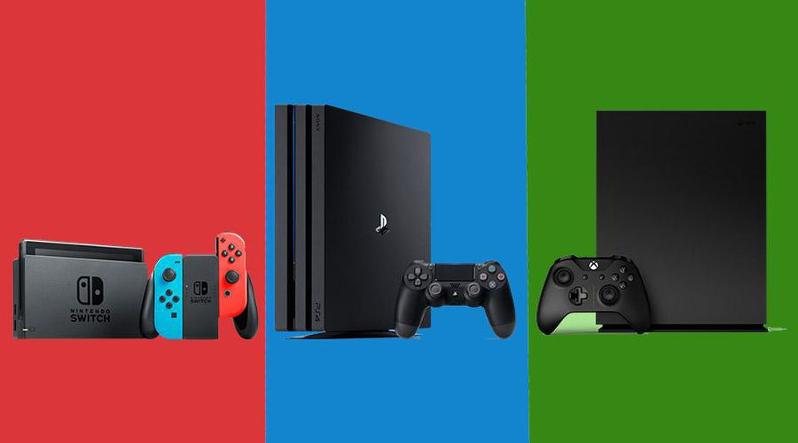
Equipment
Notes:
So let's talk about equipment. Often times you see program and club ask for a physical space to practice and compete in esports. If they are lucky enough to get support for that often the question is, what do you need? The answer is always, high-end gaming pcs. And honestly, that is a good answer. You need powerful PC's to run your standard triple A title like Overwatch or Rocket League for example. The issue with this request is that usually the conversation ends there. We student leaders, program directors, and upper administators fail to see is that there is a HUGE portion of gamers that don't play on high end PC's, and for good reason. The entry cost to a gaming pc is right around $1,000 and that is the low end. You will end up having to update rather quickly as that price point means you are cutting corners. The reality is you have to spend $1500+ usually over $2,000 for name brand and prebuilt systems to have sustainable PCs for students to engage with. That is a very high barrier to entry. Most studnets come to college bringing systems like Nintendo Switch, Xboxes, or Playstations. They are not brining all their computer equipment (mice, keyboard, mousepad, headset, monitors, and CPU), although those of us that are privledged enough to do so, will and do.
So the problem with this approach is that we end up excluding a majority of gamers in our eqiupment asks and ultimatley programming. This has a trickle down effect. If you have PC's in your physical space, you will plan events and gathering centered around those systems. The most popular gaming device in the the world is right in our hands, mobile gaming. Why is it that we don't see more intentional investment and programming around mobile and consoling gaming? While there are good answers to this, such as lack of developer support, that can't be the reason for lack of opportunites for students. Esports is stil new enough where we get to write the story on how esports should be done. Ultimatley for programming for PC events only, we are disproportionallity effecting our people of color and other minoritiezed groups as they often to not have access to Gaming PCs.

Slide 22
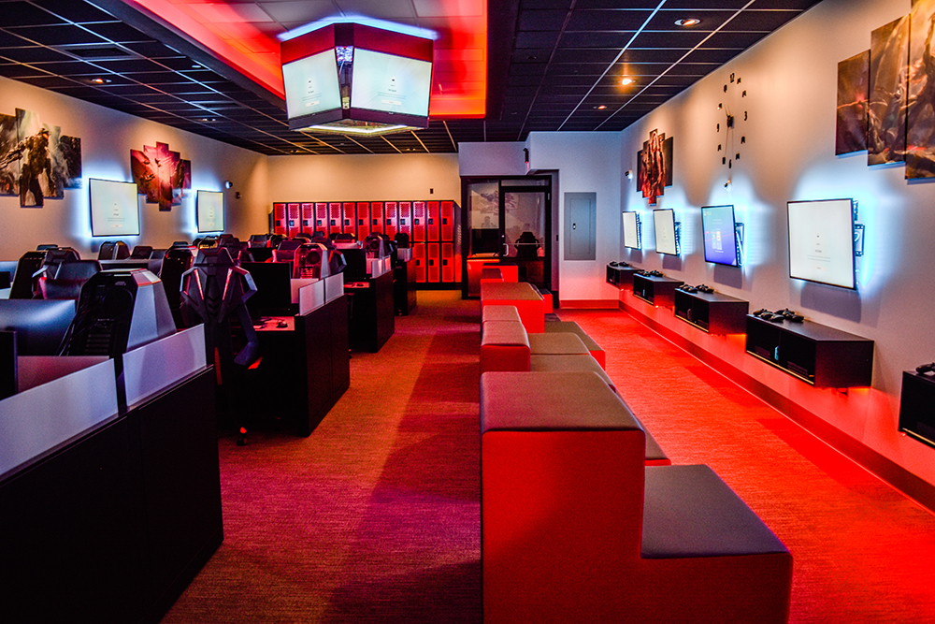
The Solution
Notes:
The solution doesn't involve removing or takinga way anything. It involved adding more and creating more opportunities. What I mean is, bring consoles into your physical esport labs and arenas. Part of the reason you might have a physical space on campus is to engage those that would not otherwise, or don't have the neccesary equipment themselves. So rather than making mom, dad, or guardian pay for a new system, they can come try it out in your space. That means you have to have the equipment there. So what this does for you as a club or program, is it allows you to then plan events using those consoles. Moreover, students now visibly see you supporting consoling gaming so they are more likely to engage. Students who engage are more likely to stay engaged. So we have almost a snowball effect, just by providing access, you will start to see more people "buy in" to esports and gaming and in turn your numbers will go up. After all, that's what a lot of people care about!

Slide 23
Upper Administration
Identify buildings or spaces for esports that are not only ADA accessible, but also ADA friendly.
Do not use buildings or spaces that are isolated from the rest of campus or poorly lit at night.
Use buildings that are regularly visited by campus security.
Make sure that there are inclusive bathrooms that are equally close to the space.
Keep the space open for hours that serve all students, including commuters. This likely means keeping the space open in the mornings as well as the evenings.
Do not employ a pay-to-play policy for the space.
First Steps - Make sure that your Title IX coordinator and your director for student diversity are part of the conversation about location, and ensure that their voices are valued as highly as that of your architect or CFO.
Notes:
Read Slide

Slide 24
Program Director
If you are a part of the planning process, request all from the previous slide from the upper administration.
Staff student workers to keep the space open from morning to evening, and train the student workers on safety procedures, with posted phone numbers for campus security or public safety.
Connect with the various populations on campus and ask them how you can make your space more accommodating.
First Steps – Reach out to a diverse group of campus partners and invite them to tour your space. Ask them what you can improve upon.
Notes:
Read Slides

Slide 25
Student Leader
Hold events in locations consistent with the last slide
Don’t hold events too late at night, as that might exclude commuters.
If you can convince your administrators to invest in an esports and gaming space, make sure they are made aware of the concerns in the previous slides.
First Steps – Hold a meeting with student leadership and dicuss location conerns. Request anonymous feedback from the student body concerning event locations and timing.
Notes:
Read Slides

Slide 26
Implicit Bias
Implicit bias is “the attitudes or stereotypes that affect our understanding, actions, and decisions in an implicit manner. Activated involuntarily, without awareness or intentional control. Can be either positive or negative. Everyone is susceptible” (Kirwan Institute, 2016, p.14).
Implicit bias is characterized by “the introspectively unidentified (or incorrectly identified) traces of past experience that mediate attributions of qualities to members of social categories” (Greenwald & Banaji, 1995, p.15).
“The science of implicit cognition suggest that actors do not always have conscious, internal control over the processes of social perception, impression formation, and judgement that motivate their actions” (Greenwald & Kreiger, 2006, p. 946).
Notes:
Now let's talk about other problems in esports. Implicit bias often occurs in gaming and esports. Here are some ways you can think about implicit bias.
Read slide
I'll now demonstrate some ways we see implicit bias manifest itself in gaming and what we can do to avoid these biases.

Slide 27
Understanding Implicit Bias
Implicit bias is the result of system 1 thinking
System 1
Unconscious reasoning
Implicit
Automatic
Low effort
System 2
Conscious reasoning
Explicit
Controlled
High effort
Kahneman, D. (2011). Thinking, fast and slow. New York, NY: Farrar, Straus, and Giroux.
Notes:
So you can start to see how implicit bias can manifest itself in gaming.

Slide 28
Defining Implicit Bias
Implicit associations are most likely to drive behavior under the following conditions:
Situations that involve ambiguous or incomplete information
Circumstances in which time is constrained
Times when cognitive control is compromised (e.g., when experiencing stress or insufficient sleep)
(Bertrand, Chugh, & Mullainathan, 2005)
Notes:
So this is really the crux of it. read slide
For example, let’s say im playing Overwatch and my team and I just barely wipe the enemy team. I might exclaim “let’s go boyz”. What you may not realize, is that the phrase “let’s go boyz” is actually quiet limiting, especially when one of your teammates is someone who identifies as a women. Being that you are in the middle of the match, and the next round starts pretty quickly, you have less time to “formulate” a reaction if you will. And that’s exactly it right? Often times these slip ups are “automatic” and almost “natural” for us to engage in. You don’t ever pause and think to yourself, okay how should I react her. You just do. Often times we don’t even realize we are doing it, thinking about to unconscious bias right?

Slide 29
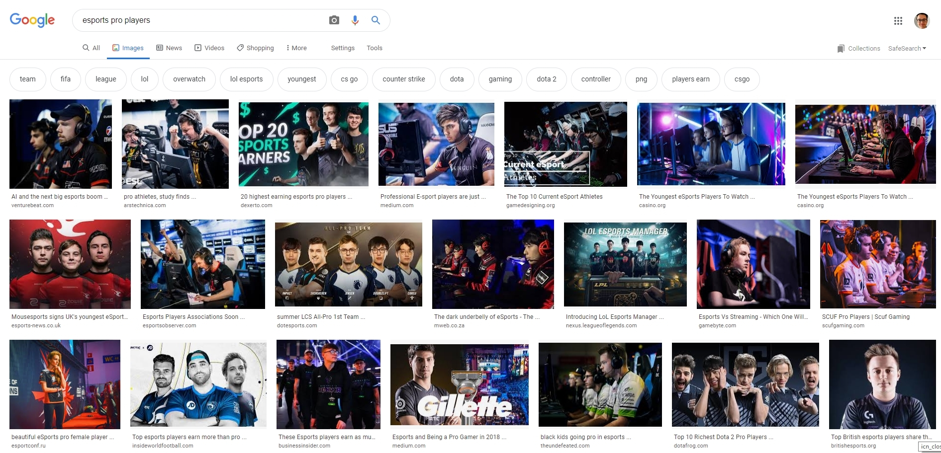
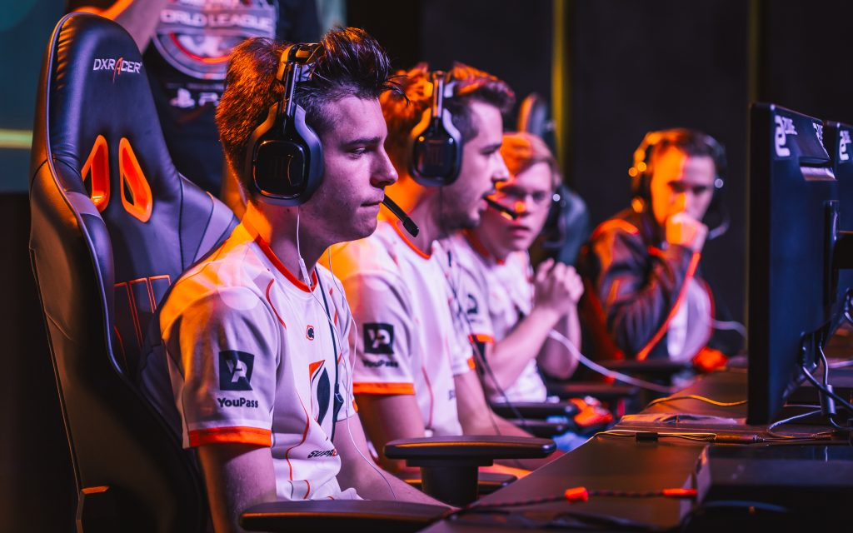
Notes:
What is the picture depicting? Very simply, what do you see here? -WAIT FOR ANSWERS OVER VOICE OR CHAT
If I search for esport pro players, this is what comes up on google images. The problem with esports is this: It's an industry that is heavily dominated by white and asain cis-gendered males. I want to make it clear that those are not bad groups of people, im in one of them. The issue arrises when people not apart of those groups don't get access and opportunity in the same ways that someone like me does. There is an assumption of lack of skill if you are a person of call or a women. You will notice in the bottom right of this picture, you can see the title of the image is "beautiful esports pro female player". A study out of Indiana University examined the different in language used towards female streamers vs male streamers on twitch. Twitch is a platform that allows people to live stream a game to the world. What they found was that female channels had language geared towards their physical appearnace, the body, relationships, and male channels had language geared twoards gameplay and strategy. There is clear objectification of women in gaming. Often they report feelings of stress and anxiety while playing games. They will often not reveal their genders simply due to the stigmas that come associated with it.

Slide 30
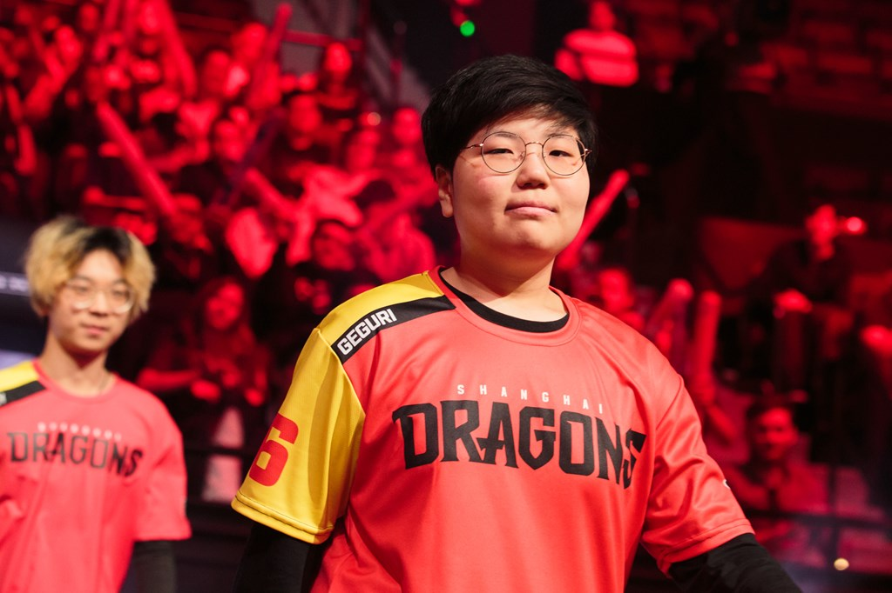
Gender Equality
Notes:
So we are talking about gender equality. I want to share with you a brief story about a women named Kim Se-yeon (Geguri as she is better known by her gamertag). She plays for the Shanghai Dragons, a South Korean Professional Overwatch team. She gained recognition in the scene after being accused of using an aim bot to play her signature Zarya in competitive play. She later proved that she was not cheating by playing several matches in a controlled setting with a camera recording her mouse hand. Geguri's accusers said they would quit playing if she was not hacking. When it was proven she was not hacking, many of the accusers quit their team and the professional Overwatch scene entirely.
Isn't that quiet distrubing? So because she was a women, people assumed she could not possibly achieve the level of success that she was, so she must be cheating. When she was rising through the scene, people didn' t know her gender. As soon as it was revealed that she was a women, people immediatley concluded that she must be cheating. After all, this is a guys sport right? Wrong. She was quoted saying "being the icon or being looked up to because I'm female-im grateful, but I don t really have any thoughts about that. That's not how I want to be known."
She should be judged based on her skill and abilities, just as everyone else is. Her gender should be irrelevant. That's the beauty of esports, you are not restricted by biology, in-so-far as we can tell thus far. Regardless of gender or race, you can be capable of being great. Now whether you have the same opportunites as other is a whole different story, but biology itself will not be the reason why you can't do well in esports.

Slide 31
Solutions
Create a safe space
Provide platforms to tell their story
Speak with, not for
Notes:
So what can we do to help bridge the gender gap that we have in esports? For starters we have to create safe spaces for women and LGBTQIA+ folks to engage in gaming. So often do we create systems of engagement without consulting important stakeholders. Women and other minorities in gaming should be included in the conversation around building a program or club. This might be creating a club exclusively for women or people of color dedicated to gaming. While esports can are arguably should be a co-ed experience, in order to get their we must provide women a space to get started. The fear of creating seperation, does not outway the benefits of providing a safe space to women and other under-represented folks, in fact we are already at the point where seperation exists. We missed the boat on "doing" esports right. It is now time to go back and write that wrong. Another thing we can do it to shine a spotlight on women in the industry. While we need to be intentional about not tokenizing them, we want to give them platforms to tell their story and talk about their lived experiences. As people who may come from a place of privledge, it is our responsibility to provide these opportunites to everyone can have a seat at the table. This could be in the form of an officer role in the club, planning an event centered around women in gaming or technology, hosting a panel of women. It is critical that we speak with women not for them.

Slide 32
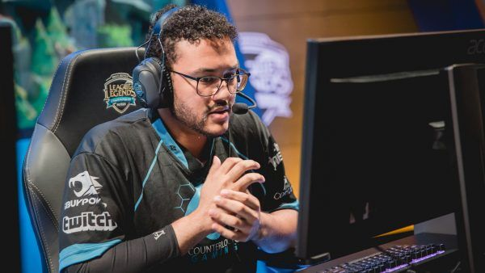
Race
Notes:
Let's talk about race and esports. Again, if you go ahead and google black esports professional players, you will find very few. We see huge discrepancies amongst our person of color in the gaming community and the majority being white and Asian decent. Back in 2015 the Pew Research Center found that 53% of black adults play video games and 48% of white adults play video games. So what that does for us, is it tells us that black people do play video games at equal or higher rates than whites, which is not necessarily surprising. After all, "anyone" can play video games right? The difference is in the support, across multiple modalities. Looking at prize pool alone, games like League of Legends and Dota 2 come in at 24 million and 5 million respectively and then fighting games like Street Fight V and Capcom Cup are at $100,000 and $380,000 respectively. As we start to think about access, the fighting game community certainly has more people of color often due to socio economic status. You could pay $5 to go to the arcade vs spending thousands on a gaming PC. So there naturally arises this issue of PC vs console play, that there are unintended consequences to decisions like restricting a pro-level league to PC play only. Back when esports was SUPER knew we could have blamed this grow on it being "organic", and that players being pushed through the scene were the best currently playing. The problem now is that investor money starts coming into esports, we often leave those on console out to dry. Thankfully esports is still new enough for actual change to occur. Speaking of change, let's talk about what you can do.

Slide 33
Solutions
Create a safe space
Provide platforms to tell their story
Speak with, not for
Notes:
Similar to gender, create a safe space for people of color and other minorities to express themselves and their gaming and gaming culture desires.
Elevate their voices, provide them with a platform to tell their story.
Include their voice in decision making, having a seat at the table can help to ensure that no one get's left behind
Speak with them, not for them.
Be intentional, specifically program for events that are accessible and free. Choosing games that are demographics of people can play. Games like Rocket League, which recently went free and now is boasting over 1 million players on a daily basis (this came from 100,000). Rocket League has cross play enabled so those playing on console can play with/against those on PC.

Slide 34
Questions?

