Slide 1
Incorporating Brain-Based Learning into Virtual Career Support and Delivery

Slide 2
Angela Evans
Doctor of Public Administration
Specialization in Organizational Leadership and Management

Slide 3
Career Development
Career development is a life-long, continuous process with many complex factors and interplay. This is also reflected in what makes up the learner of today and the demands of the current pandemic on flexible learning styles and modes of delivery to prepare for success.

Slide 4
Eclectic Brain-Based Perspectives
Collaboration &
Communication

Slide 5
Person- Centered Approach
How to empathize
Reflective listening and communicating

Slide 6
Motivational Interviewing RULE
Resist the righting reflex
Understand the person’s motivations
Listen with empathy
Empower the person

Slide 7
Readiness To Change Model
Assessing the 5 Stages:
Precontemplation
Contemplation
Preparation
Action
Maintenance

Slide 8
Play to Strengths: SNAP
Strengths
Needs
Abilities
Preferences

Slide 9
Cognitive Behavioral Approach
Event
→
Thoughts and Feelings
→
Behavior
Cognitive shortcuts help our brains focus on important information.
Notes:
Photo Idea: Noticing thoughts allows us to choose our behavior: like a fork in the road.

Slide 10
Emotional Intelligence (EI)
Gauge, emphasize, and develop EQ through:
Self awareness
Self-management
Social awareness
Relationship development
Notes:
Have to be aware of yourself before you can take care of relationships with others

Slide 11
Brain-Based Learning Approach
Activating event
Beliefs – (Remember)
Consequences – (Reflect)
Disruptive Thinking (Reframe)
Effect – (Response)
ABCDE stages

Slide 12
Peer Mentor Attributes
Curious learner
Charisma
Warm, patient disposition
Ability to put others at ease
Development of self and others
Respect & appreciation for diversity
Initiative; work ethic
Emotionally intelligent

Slide 13
Hands-On Trainability
Tech and Media Savviness
Career Testing/ Exploration
Resume/Cover Letter Documents
STAR Professionalism
Training Process

Slide 14
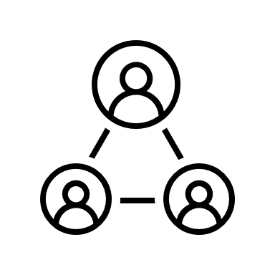
Training
FLIPPED Brain-Based Career Toolbox
LinkedIn Learning Courses
NACE - Peer Career Coaching Program
Eduology - Peer Mentor Certification Course
UIS Career Resources and Online Career Systems
Mock Scenarios
Role Playing and Shadowing

Slide 15
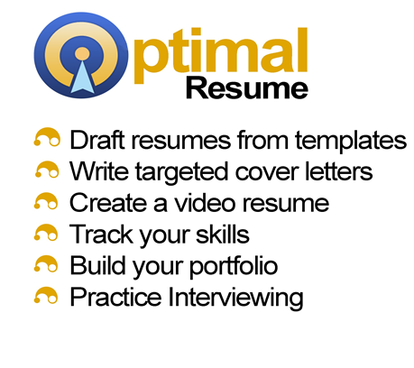
Application
Web-based, Self mediated
FLIPPED Brain-Based Career Toolbox
Live help, Interactive

Slide 16
Thank you! Dr. Angela Evans aevan01s22@uis.edu

Slide 17
Hannah Nicolaisen
Career Peer Student Mentor
Majoring in
Psychology and Exercise Science
Fourth-year, transfer Student

Slide 18
Rejected
That time I got

Slide 19
Mentor Training
+ Student Perspective

Slide 20
Flipped Learning
Apply
Changing the process of education
Ask Questions
Introduce

Slide 21
Flipped Learning
Apply
Changing the process of education
Ask Questions
Introduce

Slide 22
Barriers
Students are Busy.
to the introduction of new information.
Not sure where to Start.
Career planning can feel Scary.

Slide 23
How to:
Introduce
Must be
Accessible
Digestible

Slide 24
20x20
20 slides
20 seconds

Slide 25
Keep it Simple
Little to no text

Slide 26
Keep it Visual
Use metaphors and relationships

Slide 27
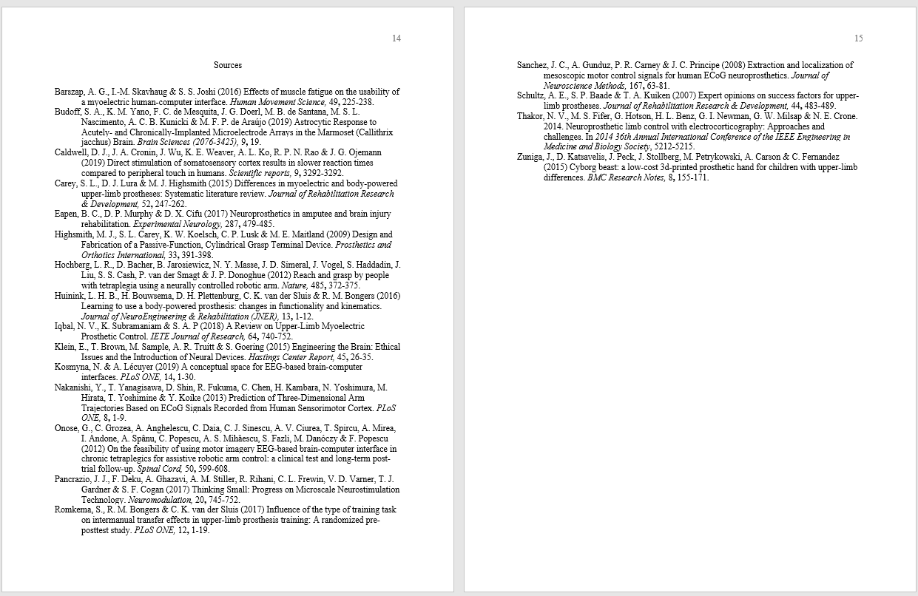
Presenting Research with PK
“Implications of neural devices on upper limb prosthesis”
15 Pages in 20 slides?

Slide 28
Success!
Over 14 presentations with unique topics.

Slide 29
Think Inside the Box
Compress big ideas, concepts or amount of information into a simplified format.

Slide 30
Application:
Resumes
Goal Planning
PK in the
Career Center:
Cover Letters
Career
Pathways
Personality
Assessment
Internship
Search

Slide 32
Polished
Notes:
The first key to success in a resume is staying polished. Consider taking a photo of a with a camera that has dust on the lens. No matter how beautiful the landscape, the photo would always come out blurry. So we need to remove any dust from our resume so that we can show an accurate picture of our abilities.

Slide 33
1.
Spelling and grammar
Notes:
We can start by focusing on spelling and grammar. Use spell check, and have somebody you trust check for hidden mistakes.

Slide 34
2.
No personal pronouns
Notes:
Next, there shouldn’t be any “I’s, me’s or my’s” in the resume. Stay strictly in third person, describing yourself from an outsiders perspective looking in.

Slide 35
3.
Consistency
Notes:
Whatever format or font styles you choose make sure it stays the same throughout the document. For example, keeping your dates in the same format and in the same location for every experience.

Slide 36
4.
Save references
Notes:
Lastly, take the references off the resume. If an employer is interested, they’ll ask for references later on, but make them take the first step.

Slide 37
Benefits of PK:
Record and share on other platforms
Use for presentations
Brief and accessible

Slide 38
Do it yourself:
PechaKucha.com
Or just use PowerPoint!

Slide 39
Thank you! Hannah Nicolaisen hnico2@uis.edu
Notes:
11:20; 12:39;

Slide 40
Mildred Wallace
Career Peer Student Mentor
Majoring in
Medical Laboratory Science
Third-year Student

Slide 41
College is a LIFE transition

Slide 42
A typical student can have numerous passions.

Slide 43
Which path would I choose?
Doctor?
Meteorologist?
Zoologist?
Psychologist?

Slide 44
Where do I start?

Slide 45
Hi! I’m a Career Advisor and I am here to provide you with resources, how can I help?

Slide 46
Career Peer Mentor
Relate
Offer Guidance and Resources
Aid in Career Path

Slide 47
Emotional Intelligence

Slide 48
1.What is Emotional Intelligence?
Expression of Emotions
Effective Communication
Empathy

Slide 49
2. Why is Emotional Intelligence important?
Able to reach students and peers
Have valuable and lasting impact
Improve in self-awareness, empathy, motivation, and resilience

Slide 50
Career Development Center
Notes:
Resource
Guide
Motivate

Slide 51
GOALS Program
Includes 5 Career Planning Stages
Gaining Self-Awareness
Options to Explore
Action Decision Making
Launching Your Career
Self-Reflection

Slide 52
Gaining Self-Awareness Identification of:
Interests
Skills
Values
Personality

Slide 53
Options to Explore, Research and Learn:
Majors
Occupations
Labor Market
Companies

Slide 54
Active Decision-Making
Experience Potential Career
Job Shadowing
Internships
Networking

Slide 55
Launching Your Career
Prepare for After Graduation:
Resume
Interviewing
Job Search
Offer Evaluations
LinkedIn

Slide 56
Self-Reflection
Reflect and Evaluate:
Current Position
Family Considerations
Career Transition
Career Path

Slide 57
Online Career Chat

Slide 58
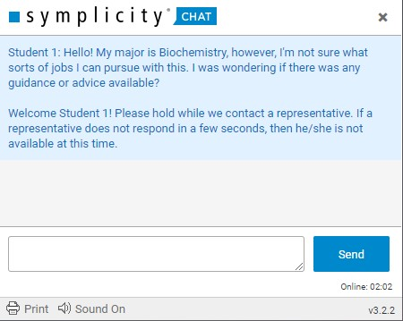
Simplicity
Online Career Chat
Secure
Safe
Access and log in outside of school

Slide 59
Career Chat Templates
Emotional Intelligence is crucial to communicating virtually!
Tailor needs to specific student
Able to connect and reach out to students virtually
Providing structure, standardization, and personalization of method
Maximize resource capabilities

Slide 60
Career Chat Templates
Example: Using GOALS in Chat
Hello! My major is biochemistry, but I’m unsure of what career paths and job options there are for me. Is there information on what I can do for my major?
Example of using GOALS in Chat
This is an excellent question! The Career Development Center is here to help. On our website you can access…
Thank you so much for you help!

Slide 61
Incorporating GOALS into chat templates allow for standardization of resource referrals to make sure each student gets their career needs addressed.

Slide 62
We all learn and mentor in different ways. As we shape and teach others, we are also teaching ourselves!

Slide 63
Thank you! Mildred Wallace mwalla22@uis.edu

Slide 64
Wrap Up:
In conclusion, we have offered a purposeful, enhanced focus on brain-based, pseudo-flipped career training and applicable experiential learning strategies. Such an eclectic toolbox is needed to meet and adapt to the learner of today and the demands of the current pandemic in flexible learning styles and modes of delivery to prepare for success.

