Slide 1
Assessment as Instruction:
Strategies for Fostering Equity & Growth Mindset
RISE Conference
Eastern Illinois University
October 16, 2020

Slide 2
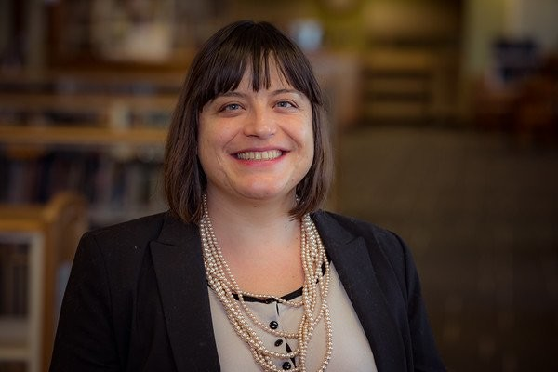
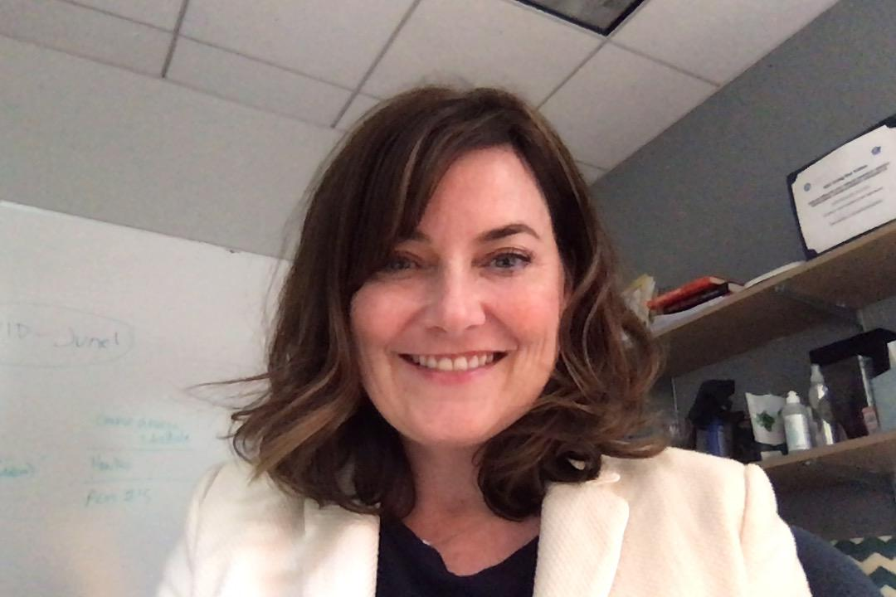
Who are we?
Margeaux Temeltaş
English Department Chair
& Assistant Professor
National Louis University
Stephanie Poczos
Associate Dean of General
Education & Pathways
National Louis University

Slide 3
Session Outcomes
Participants will learn how to:
Use rubrics and assessments as learning tools in the classroom.
Make assignment and assessment expectations transparent to students.
Empower students as agents in their own learning.
Utilize metacognitive assessment practices to build growth mindset.
Infuse social-emotional learning while developing writing and other academic skills.
Cultivate the classroom culture needed for successful peer assessment and peer-to-peer (reciprocal) learning.

Slide 4
Assessment-as-Instruction: Key Practices
This session will cover 3 key forms of using assessments as learning activities:
Assessing Sample Products Using the Rubric
Peer-to-Peer Feedback
Self-Assessment and Reflection

Slide 5
Foundations of a Learning Community
Integrating successful peer-to-peer assessment requires first building a strong classroom community where:
Students hear that they belong and can be successful.
Students feel safe to take risks and share their work.
Positive feedback (“glows”) and constructive criticism (“grows”) are intentionally modelled by the instructor.
Feedback is concrete and growth-based as “feed-forward.”
All students are continuously challenged at their “appropriate edge.”

Slide 6
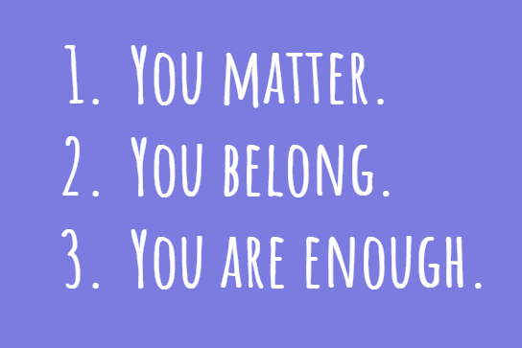
Example Instructor Values

Slide 7
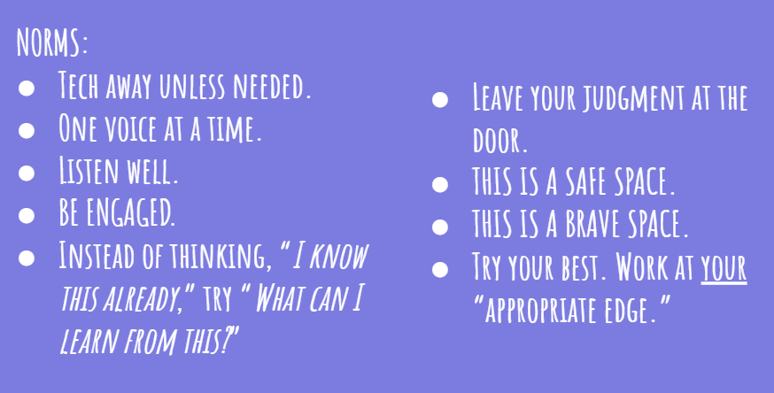
Example Classroom Norms

Slide 8
Audience Check-In and Discussion
If you currently use class norms,
where and how often
do you communicate them?
Please type your responses into the Zoom Chat:

Slide 9
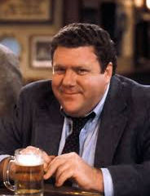
Classroom Norms, Session Norms
Classroom norms are introduced in the first class session and returned to regularly throughout the term.
When possible, involve students in the creation of classroom norms.
As new learning activities are introduced and assessment-as-instruction practices scaffold up, students are encouraged to discuss how classroom norms apply to the specific activity.

Slide 10
Building Growth Mindset
Based on the work of Carol Dweck (Mindset, 2006)
“My intelligence is static.”
“My potential is pre-determined.”
“My intelligence can be developed.”
“Failures offer opportunities for growth.”
“Feedback & criticism are personal.”
“ I learn from feedback.”
“I’m either good at it or I’m not.”
“I am inspired by other people’s success.”
“I avoid challenges.”
“I embrace challenges.”
“There is no point in trying.”
“I keep trying and never give up.”
FIXED MINDSET
GROWTH MINDSET

Slide 11
Audience Check-In and Discussion
If you currently use your rubrics
as learning tools,
when and how do you do this?
Please type your responses into the Zoom Chat:

Slide 12
Assessment-as-Instruction: Key Practice #1
Assessing Sample Products Using the Rubric
Analyzing, scoring, and discussing high-quality samples of essays and other assessment products before students attempt the assignment.
Instead of just being a tool for instructor grading, the rubric becomes a tool for students to understand assignment expectations, set goals, and identify areas for growth.
Exposure to high-quality sample products means students actually understand what is being asked of them.
By analyzing both the strengths and the growth areas of sample products, students see writing as an ongoing improvement process and begin to develop growth mindset about their own writing.

Slide 13
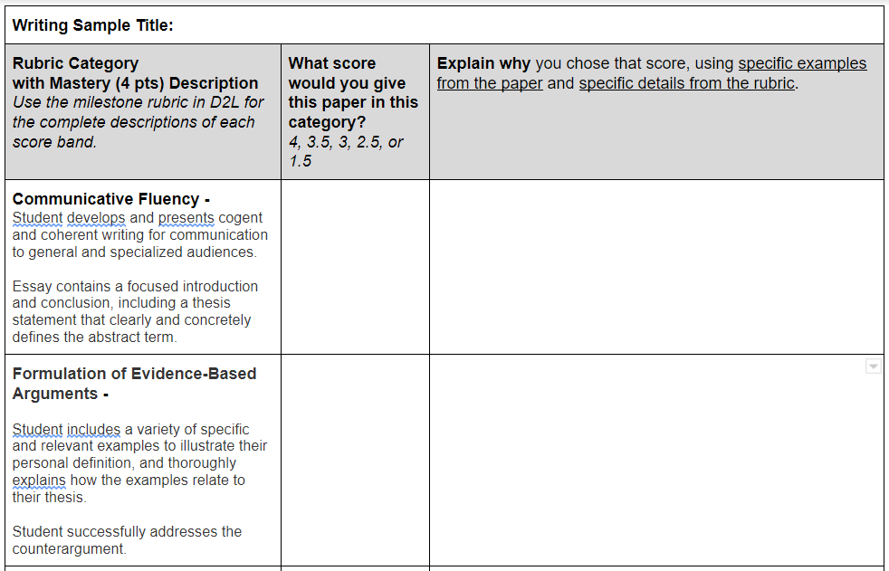
Assessing Sample Products Using the Rubric

Slide 14
Audience Check-In and Discussion
If you have a peer-to-peer feedback practice, what approaches do you use?
Please type your responses into the Zoom Chat:

Slide 15
Assessment-as-Instruction: Key Practice #2
Peer-to-Peer Feedback
Be sure to first model “feed-forward” feedback in your own early grading, so that students have language to use when giving feedback to each other.
Provide sentence stems for giving both positive and constructive feedback.
Create opportunities for cycles of revision, so that students can implement the feedback they receive.
There are a variety of peer workshop structures. Start simple, and scaffold up.
Assign workshop partners and small groups intentionally, so that students are working in their “zone of proximal development” (i.e. at their “appropriate edge”).

Slide 16
What is “Feed-Forward”?
TRADITIONAL FEEDBACK:
Focus is on measurement
Points out problems
Emphasis on the past
Is an “information dump”
FEED-FORWARD:
Focus is on improvement
Suggests steps for revision / next time
Precise, specific, and focused on just a few things
Links to additional resources on utilizing a “feed forward” approach in higher ed are linked at the end of this presentation.

Slide 17
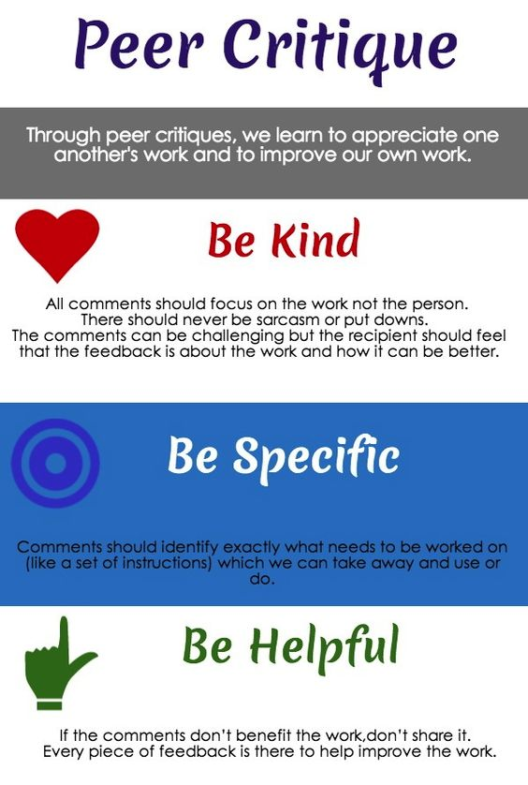
Rules for Critique
According to Ron Berger’s “Rules for Critique,” effective feedback should be kind, specific, and helpful.
Model this approach in your written instructor feedback.
Provide sentence stems for students to give peer feedback.

Slide 18
Audience Check-In and Discussion
If student self-assessments are part of your practice, when and how do you use them?
Please type your responses into the Zoom Chat:

Slide 19
Assessment-as-Instruction: Key Practice #3
Self-Assessments and Reflections
Self-assessments can be formative or summative.
Examples of formative self-assessments:
Process Pages
Assignment Reflections
Examples of summative self-assessments:
Portfolios
Capstone projects
Final Reflections

Slide 20
Self-Assessments and Reflections
Process Pages (formative):
Accompany students’ essays and other assignment submissions.
Yield helpful information about the intellectual and social-emotional contexts in which the student is working, providing data for instructors to help personalize instruction, feedback, and support.
Students reflect on what practices help them be successful, and identify changes for next time.
Students cultivate growth mindset, seeing writing as a process that can be shaped and improved, rather than having a fixed view of themselves as a “good” or “bad” writer.

Slide 21
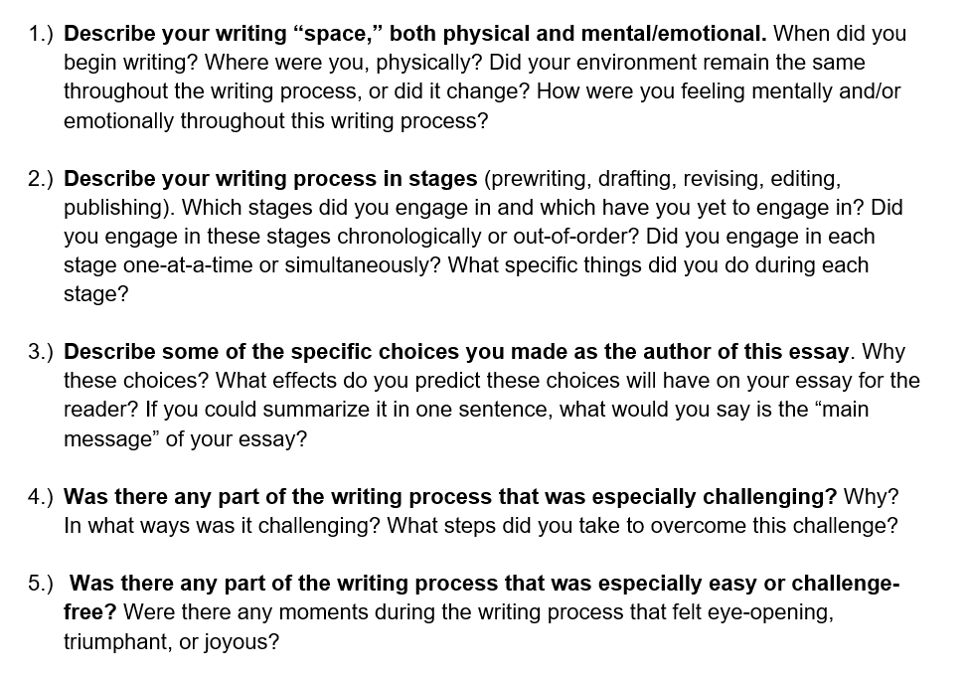
Sample Process Page Questions
Sample Process Page Questions:

Slide 22
Self-Assessments and Reflections
Reflections (formative):
Students can write reflections on their performance assessments after receiving peer and instructor feedback.
Great to use with performance tasks such as speeches.
Create opportunities for students to reflect on and integrate peer feedback into their personal self-assessment.
Students often find that the peer feedback they received is well-aligned with their own self-assessment, underlining their own conclusions.
Students are often pleasantly surprised at the positive feedback they receive from peers, helping them break their own negative self-view and move away from fixed mindset and toward growth mindset.

Slide 23
Sample Formative Reflection Questions

Slide 24
Self-Assessments and Reflections
Reflections (summative):
Students can write final reflections to accompany a collection of their work across a course, term, or year.
Great to use with portfolios and capstone projects.
Create opportunities for students to reflect on their long-term growth and learning.
By reviewing their own work across a longer period of time, students can see how much they have grown, cultivating growth mindset they will carry with them beyond an individual course.

Slide 25
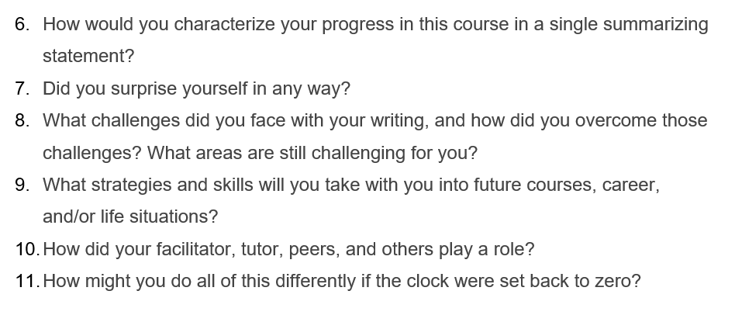
Sample Summative Reflection Questions

Slide 26
Demonstrating Growth Mindset
Quotes from students after using these practices:
“I was surprised by how my writing got better and better in just one semester. I can’t wait to improve my writing more throughout my college and future career. I truly believe I am a wonderful writer.”
“This quarter in college, I have learned that I am a great writer. I’ve learned that anything is possible when I have a growth mindset at all times. As a writer, I’ve grown by learning from the mistakes I’ve made in assignments...I was always afraid of judgment and the opinions of others. But I’ve realized we are all human.”
“I feel proud of myself for stepping out of my comfort zone and working at my appropriate edge.”

Slide 27
Demonstrating Growth Mindset
“The moments that are still fresh to mind from this course would have to be how vulnerable I allowed myself to be with my writing. I never let anyone read my writing because I did not think it was good enough, but I did this semester…[Our professor] helped me feel a lot more confident with my work. She always encouraged us to push ourselves and it really helped.
When you push yourself, you realize how brave you actually are.”
“My progress in this course is impressive, at first, I was so scared, but now I know that I can do anything I put my mind to.”
“Throughout the process of this chapbook as well as the course, my writing has improved significantly. I have become expressive in the writing and I can look at it with pride. This course has proved to me that anyone can write with meaning. I can proudly show my story of my growth as a person in an ever-changing world.”

Slide 28
Further resources about “feed-forward”
Hine, B., & Northeast, T. (2016). Using feed-forward strategies in higher education. New Vistas, 2(1), 28-33. https://core.ac.uk/download/pdf/96570274.pdf
Rysdam, S. & Johnson-Shull, L. (2015). Introducing feedforward: Renaming and reframing our repertoire for written response. Journal of the Assembly for Expanded Perspectives on Learning, 21, 69-85. https://trace.tennessee.edu/cgi/viewcontent.cgi?article=1282&context=jaepl

Slide 29
Audience Check-In and Discussion
Questions/comments for the presenters or session participants?
Please type your responses into the Zoom Chat:

Slide 30
How to reach us...
Margeaux Temeltaş
English Department Chair
mtemeltas@nl.edu
LinkedIn
Stephanie Poczos
Associate Dean
stephanie.poczos@nl.edu
LinkedIn

