Slide 1
Natural History Collections:
Connecting With Faculty and Content
Stacey Knight-Davis, Head of Library Technology Services
Todd Bruns, Institutional Repository Librarian

Slide 2
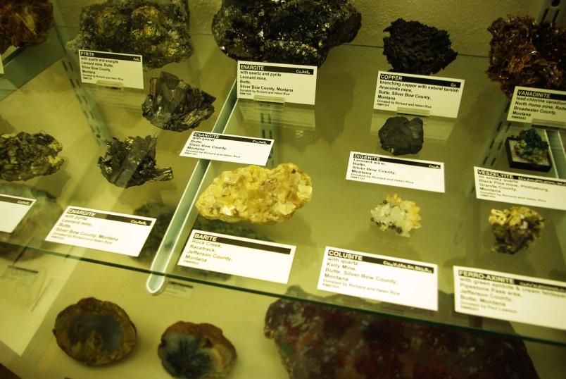
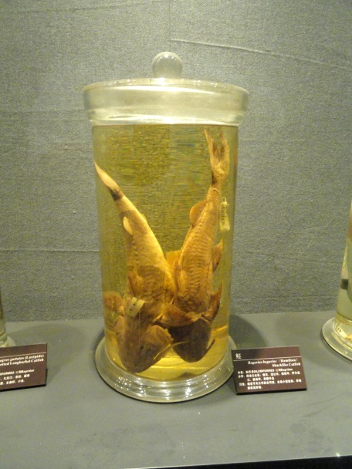
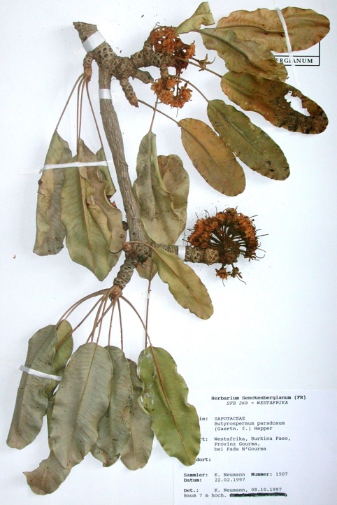
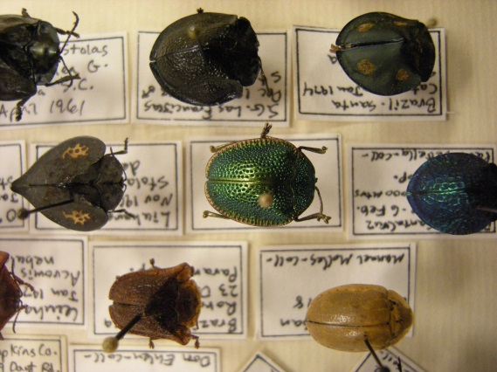
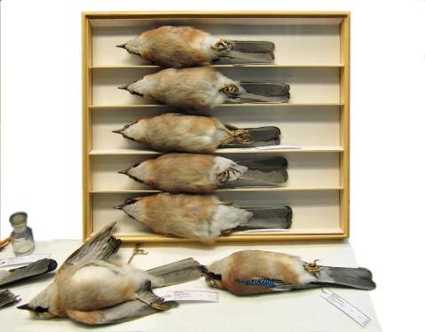
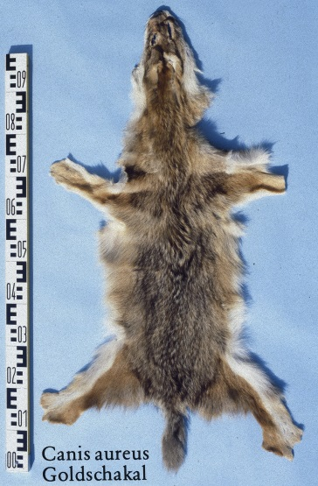
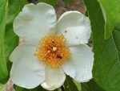
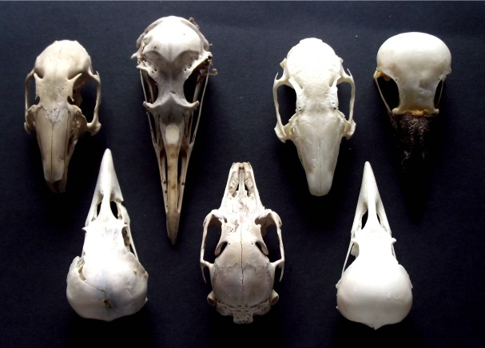
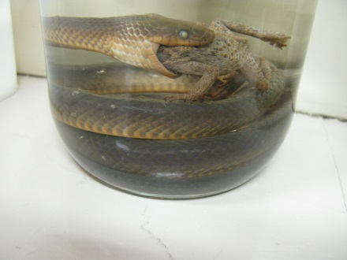
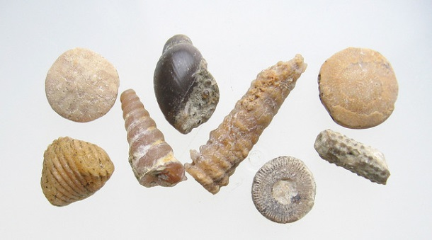
Natural History
The study of the whole natural world, including mineralogy and paleontology.

Slide 3
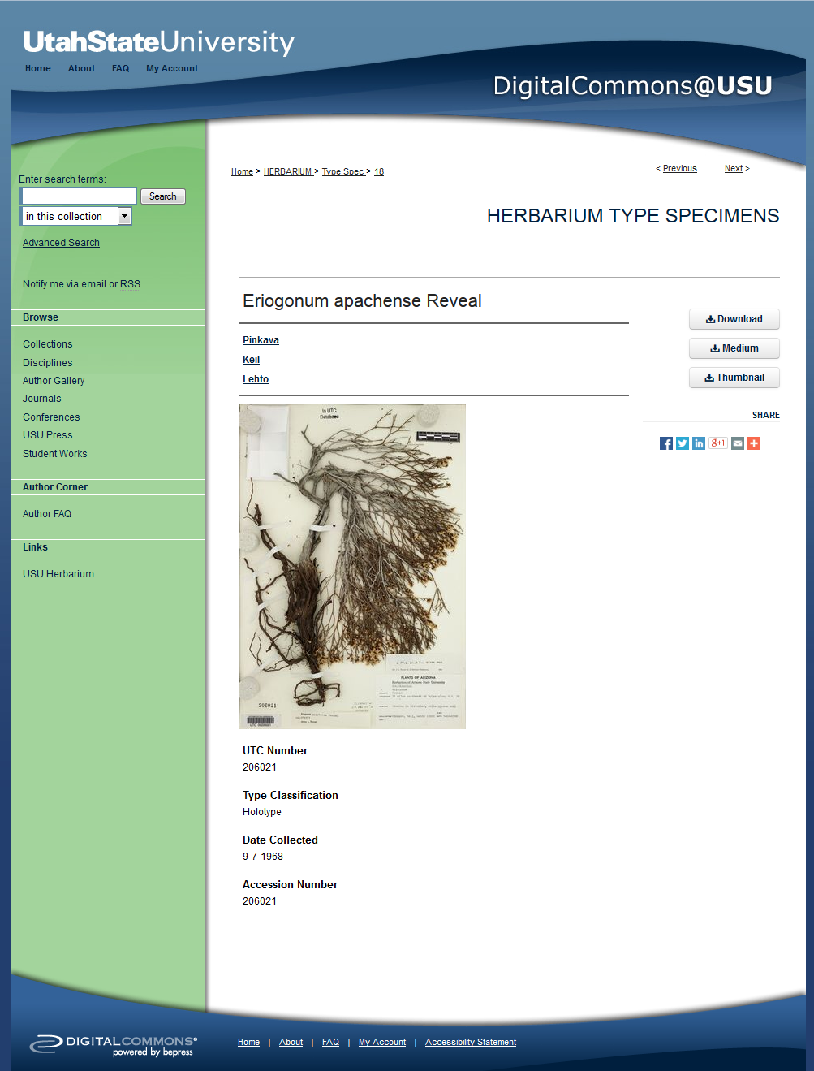
Natural History in Digital Commons
Utah State University Herbarium Type Specimens
http://digitalcommons.usu.edu/herbarium/

Slide 4
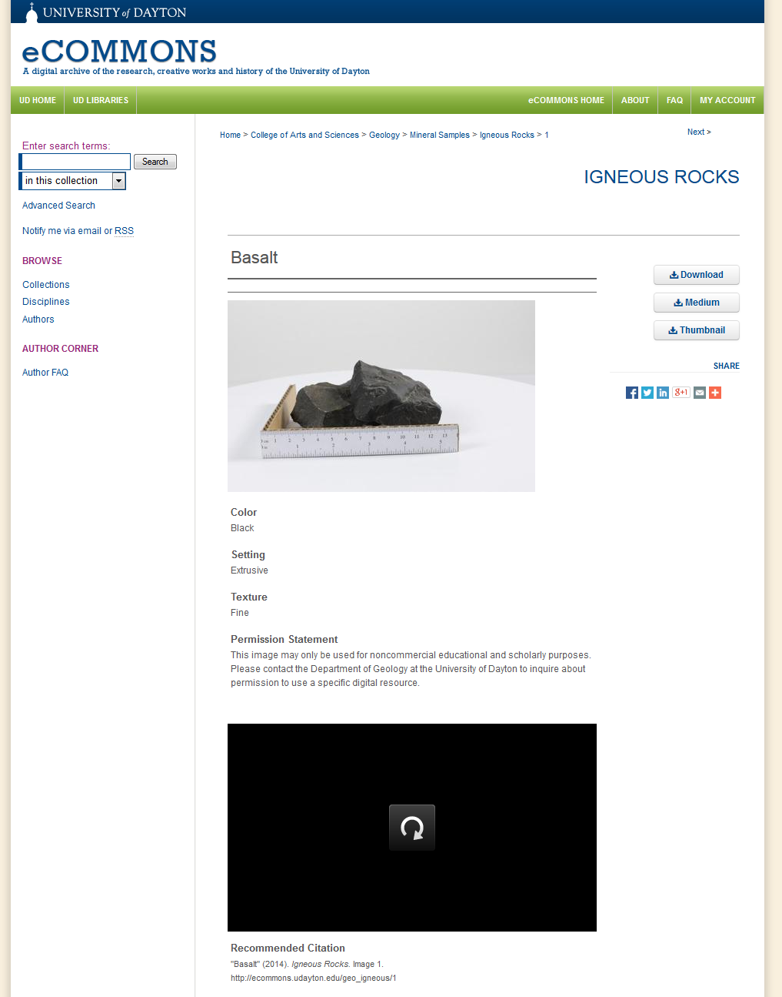
Natural History in Digital Commons
University of Daton Mineral Samples
http://ecommons.udayton.edu/geo/

Slide 5
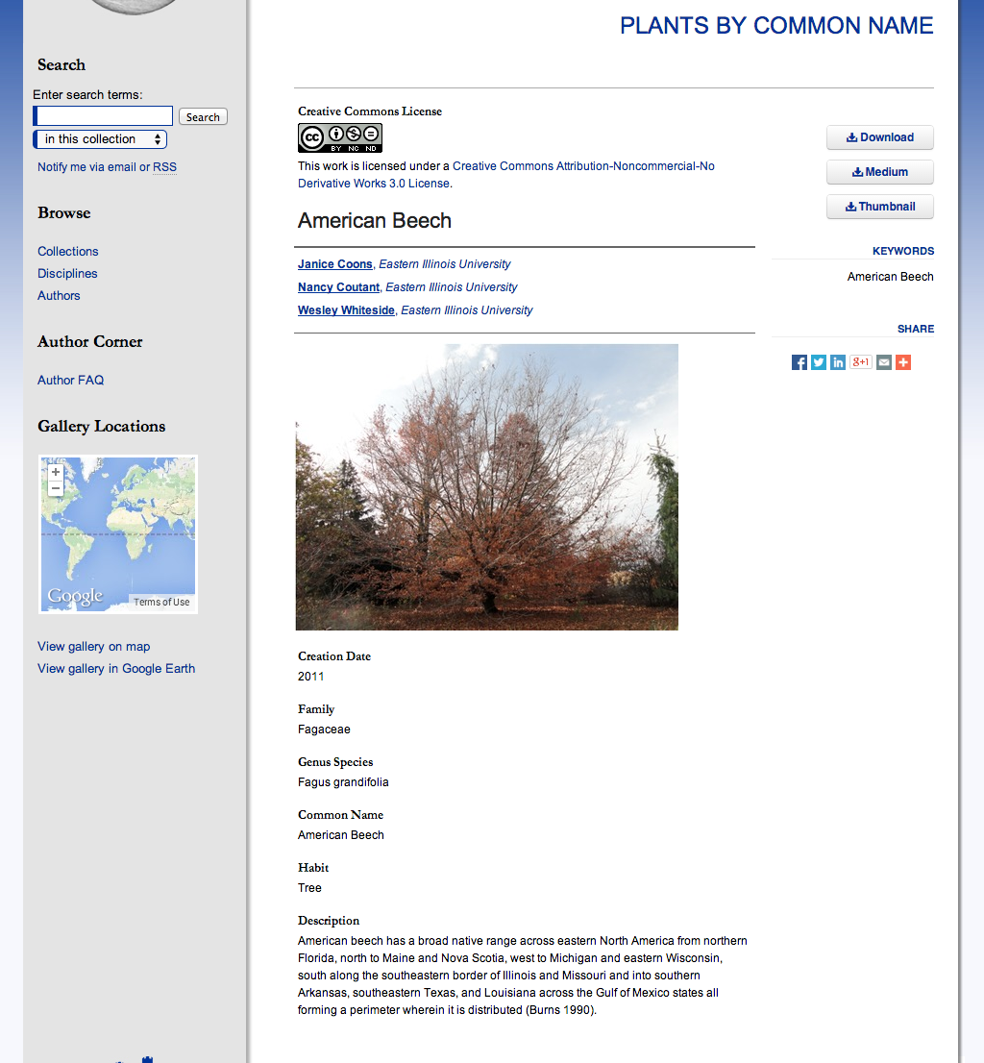
Whiteside Garden

Slide 6
Stover-Ebinger Herbarium
Founded 1899
78,000 specimens
Flora of the midwestern United States
Most from Illinois
Also includes other states and countries

Slide 7
Classroom use of specimens
Plant Taxonomy
Dendrology
Local Flora
Wetland Plants
General Botany
Ethnobotany
Plant Evolution and Systematics

Slide 8
Getting Started
Collection of importance to students and researchers
Library collaboration with departmental faculty and administration
Planning, planning, planning, tons of research, more planning

Slide 9
What we have
78,000 physical specimens
Electronic records for 15,789 specimens
Limited funds

Slide 10
Proposed Workflow
Import existing metadata as a batch
  15,789 records
Digitize specimens
Add images to existing metadata records
Add images and metadata for specimens without existing records as batch

Slide 11
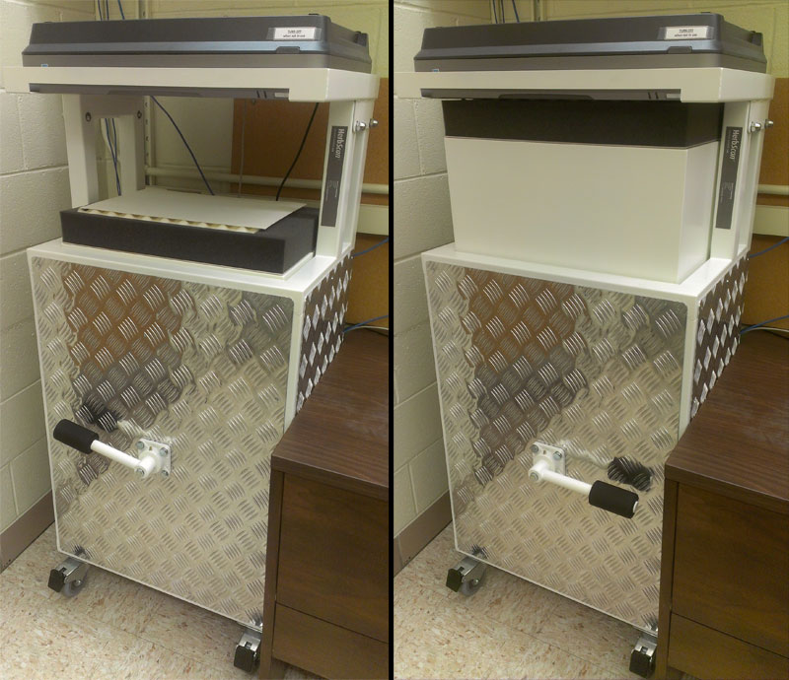
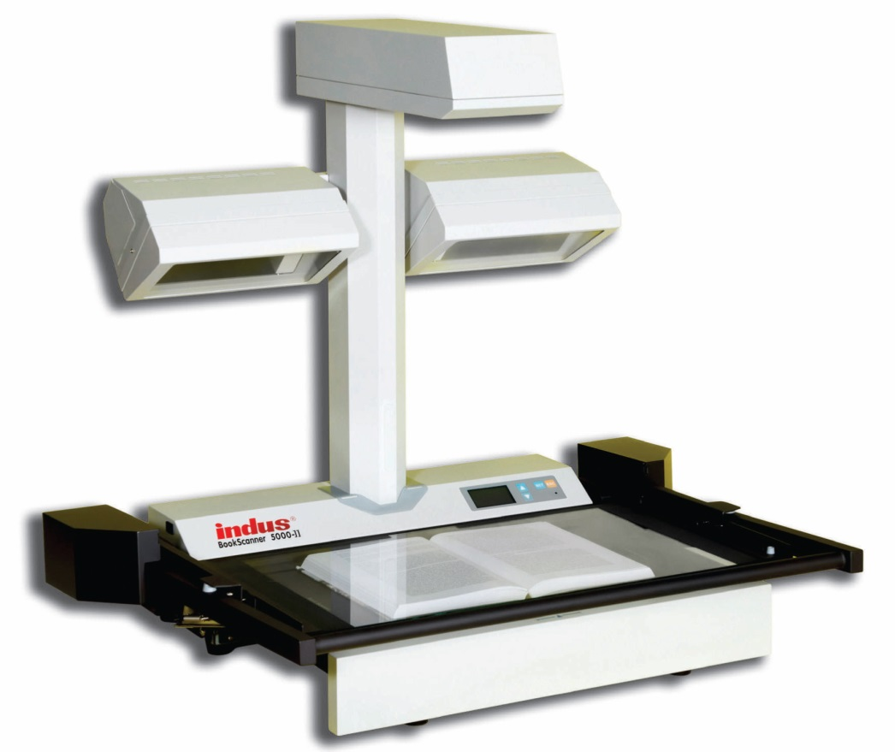
Digitization
HerbScan
Flat-bed
book scanner
Copy stand

Slide 12
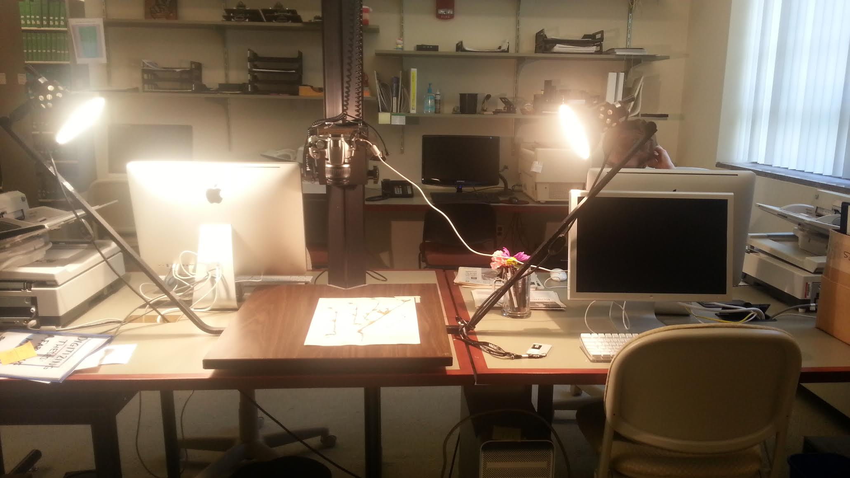
EIU copy stand
Notes:
Triggered by software
Remote viewer

Slide 13
Image Standards
Color consistency?
Size?
Image quality?

Slide 14
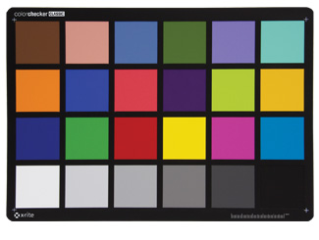
GretagMacbeth Mini ColorChecker Chart

Slide 15
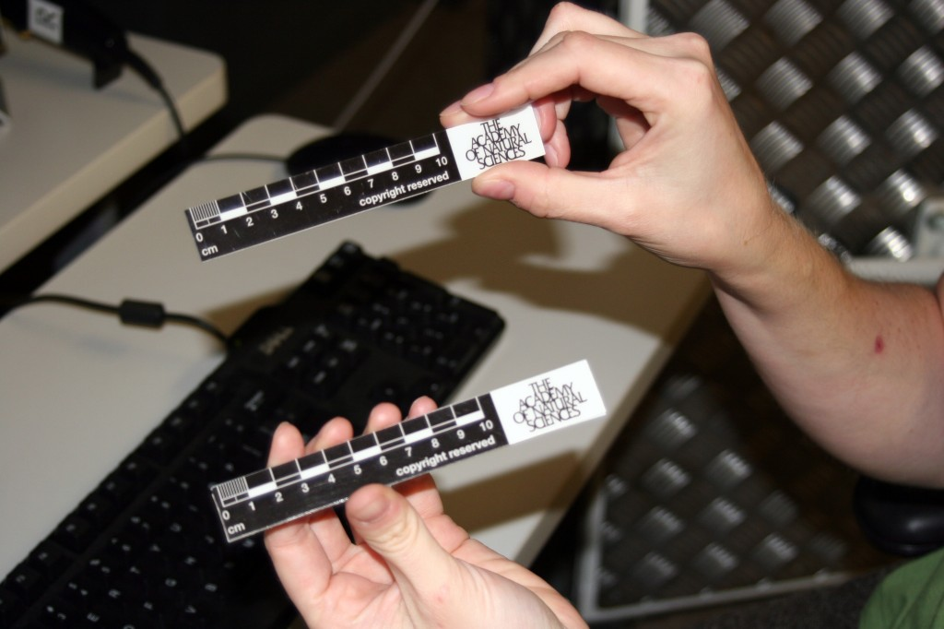
Ruler

Slide 16
Image Quality
Current setup
Recommended
8 megapixels (3456 x 2304)
300dpi at 10x14
8.3MB file size
20+ megapixels
600ppi at 11x17
24 bit color
200 MB file size

Slide 17
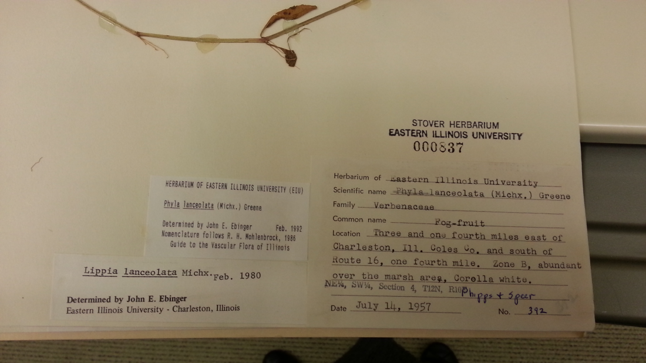
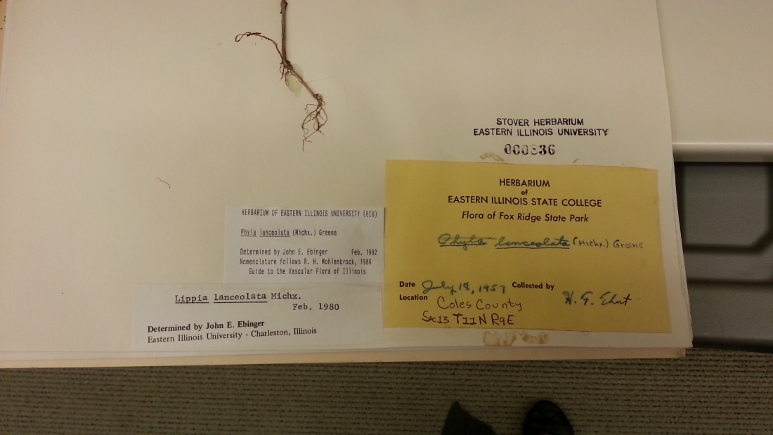
Label Data
Accession number
State
County
Genus
Species
Location
Description
Collector
Larger project
Date collected

Slide 18
Database Fields
ID Number/Accession number
Family
Genus
Species
State
County
Authority
YYYYMMDD
Infraspecific
Determined
Country
Locality
Legal
Lat-Long
Habitat
Field Number
Cultivated
Notes
Project
Date
Collector(s)
Duplicates
Day
Month
Year
Herbarium
Barcode

Slide 19
Standards
Metadata Standards
ABCD - Access to Biological Collection DataA standard for the access to and exchange of primary biodiversity data, including specimens and observations.
Darwin CoreA body of standards, including a glossary of terms (in other contexts these might be called properties, elements, fields, columns, attributes, or concepts) intended to facilitate the sharing of information about biological diversity by providing reference definitions, examples, and commentaries.
EML - Ecological Metadata LanguageEcological Metadata Language (EML) is a metadata specification particularly developed for the ecology discipline.
Genome MetadataDescriptive data about single genomes within the Pathosystems Resource Integration Center.
ISA-TabA general purpose framework with which to capture and communicate metadata for data files from 'omics-based' experiments employing combinations of technologies.
MIBBI - Minimum Information for Biological and Biomedical InvestigationsA common portal to a group of checklists of Minimum Information in nearly 40 biological disciplines.
Observ-OMUsed to integrate and compare observation data across experimental projects, disease databases, and clinical biobanks.
OME-XML - Open Microscopy Environment XMLA metadata standard and data file format for biological light microscopy data.
Protocol Data Element DefinitionsUsed by the the National Institutes of Health (U.S.) for the the ClinicalTrials.gov website. The Protocol Registration System (PRS) is used to register clinical studies with human subjects.
Repository-Developed Metadata SchemasSome repositories have decided that current standards do not fit their metadata needs, and so have created their own requirements.
- See more at: http://www.dcc.ac.uk/resources/subject-areas/biology#sthash.wJ1h2gXP.dpuf

Slide 20
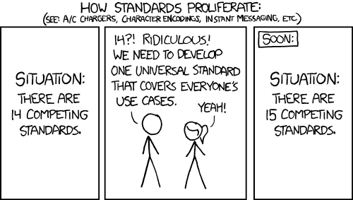
http://xkcd.com/927/, hat tip to Deborah Paul

Slide 21
Apple Core
Detailed guidelines based on best practices for publishing botanical specimen information as Darwin Core (DwC).
https://code.google.com/p/applecore/

Slide 22
Apple Core - Recommended
Apple Core
Database
dcterms:type
collectionCode
basisOfRecord PreservedSpecimen
catalogNumber
recordNumber
recordedBy
eventDate
Country
stateProvince
Locality
decimalLatitude, decimalLongitude
identifiedBy
scientificName
kingdom
Added field - StillImage
EIU
Added field - PreservedSpecimen
ID number
Field Number
Collector(s)
Date
Country
State
Locality
Lat/Long or Calculated
Determined
Family + Genus + Species + Infraspecific
All Plantae at this point

Slide 23
Apple Core - Useful
Apple Core
Database or Label data
dcterms:Rights
dcterms:bibliographicCitation
institutionCode
occurrenceRemarks
verbatimEventDate
Habitat
verbatimLocality
infraspecificEpithet
vernacularName
Included by Digital Commons
Included by Digital Commons
EIU
Notes
From Label
Habitat
From label
Infraspecific
From label, common name

Slide 24
Sharing and linking data
Global Registry of Biorepositories (GRBio)
  http://grbio.org/
  EIU <IH>
iDigBio Integrated Digitized Biocollections
  Data ingestion documentation
    https://www.idigbio.org/documentation/data-ingestion
GBIF Global Biodiversity Information Facility
  Integrated Publishing Toolkit
    http://www.gbif.org/ipt

Slide 25
Next Steps
Visit to UIUC Herbarium
Pursue funding for imaging equipment
More meetings and planning
Add metadata from database to Digital Commons

Slide 26
Further Reading
Integrated Digitized Biocollections (iDigBio)
  wiki : https://www.idigbio.org/wiki/index.php/Wiki_Home
  working groups:
    NANSH Working Group (North American Network of Small Herbaria)
    Small Collections Network Working Group
  databasing specimens: https://www.idigbio.org/wiki/index.php/Databasing_References
Global Biodiversity Information Facility (GBIF)
  http://www.gbif.org/
Darwin Core schema
  http://rs.tdwg.org/dwc/terms/index.htm
Special thanks to Susan Braxton, Prairie Research Institute, Champaign, IL

